Slide 1
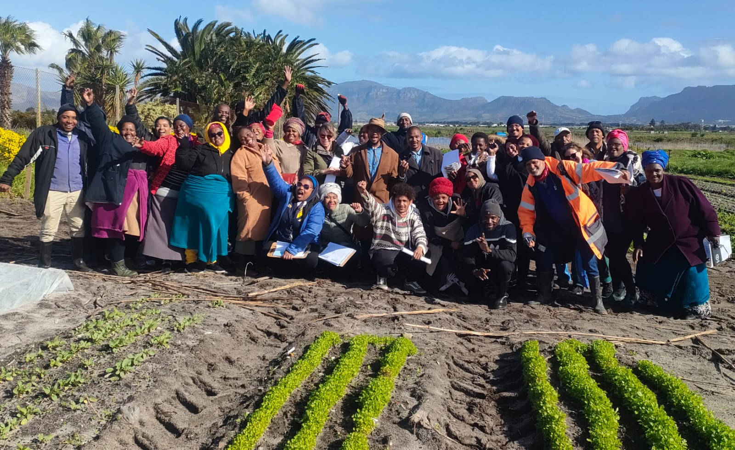

Agro Processing in PGS -
South Africa.
Realities and challenges

Slide 2


Slide 3
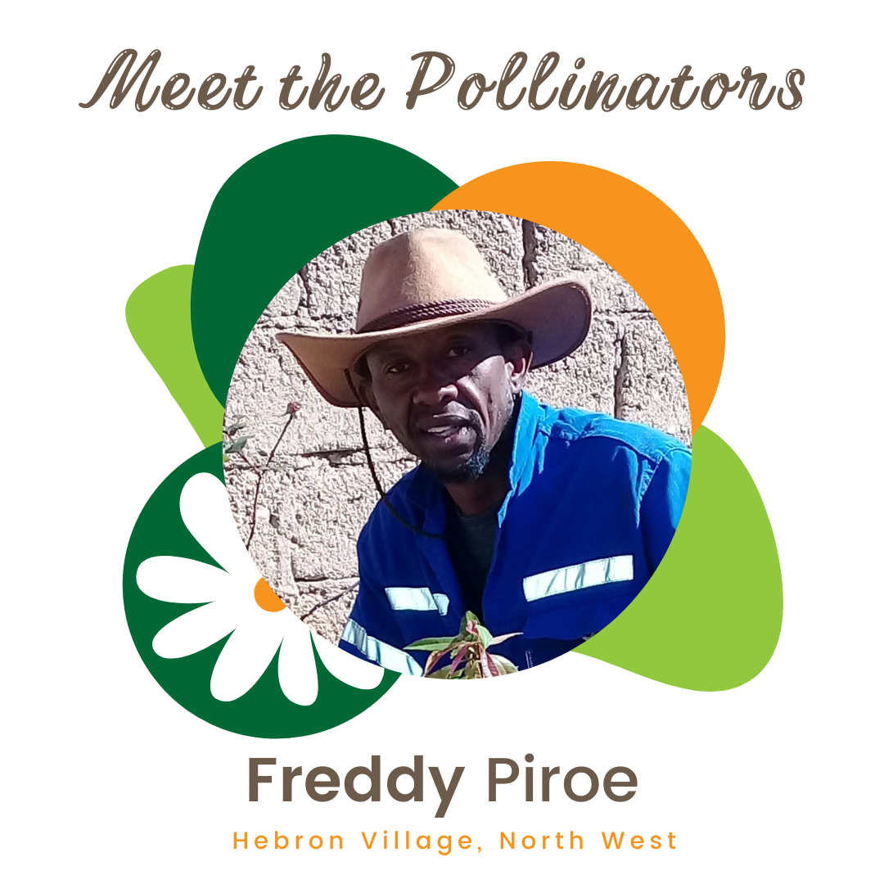
Key achievements
PGS Pollinator Programme module 1,2,3 have been completed, and establishment of groups have begun.
23 Groups have been established through the KHSA programme.
SAOSO organic standard is now live with certification services offered by Control Union. Printed copies of standard distributed to Pollinators and producers.
PGS groups adopting the SAOSO Standard and now value chains are beginning to emerge.
Notes:
• [PGS Note] Just for information for those who are not engaged in organic agriculture every day, PGS stands for ‘participatory guarantee systems’. PGSs are locally focused quality assurance systems. They certify producers based on the active participation of local stakeholders and are built on a foundation of trust, social networks and knowledge exchange. PGS is gaining traction worldwide as an accessible and appropriate model for smallholder organic farmers seeking local markets. The South African Organic Sector Organisation (SAOSO) in collaboration with Participatory Guarantee System (PGS) South Africa (SA) has launched South Africa’s first Ecological Organic Agriculture Pollinator programme. This programme is training 20 people to set up PGSs throughout South Africa that will help build more connected local food systems, provide organic assurance for consumers and support organic growers in sharing knowledge. Pollinator Programme (South Africa): The development and delivery of module 1 of the PGS pollinator programme took place in January and February 2021 as online training. The establishment of PGS groups has begun and farm visits have taken place. The second training module is scheduled to take place in 2021. The Pollinator Programme has attracted good media coverage in South Africa, profiled in leading print and online newspapers and PGS SA has managed to secure a regular column in the online Green Times newspaper. This coverage has resulted in about 1 000 enquiries a month through the website
On completion of training, the Pollinators will continue to support the activities and growth of the newly created PGS group providing ongoing extension support to organic farmers. Municipalities will be approached to provide further support to PGS groups as these groups can play an important part in local economic development.. •

Slide 4

NPC –
SAOSO Foundation
Core Vision
Promoting sustainable development and climate change adaption through a clean and ethical food system that preserves the health of soil for the 7th Generation.
Strategy
Climate Change Adaption through Land Care
Green Economy
Establishment of Grassroots Movements
Food System Transformation
Circular Economy
Environmental, Social Governance
Sustainable Development Goals
Board of Directors
Operations – Core team (Paid Staff)
Training, Research & Extension
Advocacy & Communication
Value Chain & Market Development
Network & Partnerships
Program Development & Innovation
Standards & Certification
Preservation of indigenous knowledge systems.
Action drive research for organic agriculture and food system.
Development of training programs
Skills development youth and woman.
Extension service will transfer skills to farmers and communities.
Establish alternative to FISP.
Developing targeted campaigns
Policy reform for Agroecology and Organic Agriculture.
Civil society participation in shaping the future of the food system.
Brand development for organic
National information and communication strategies.
Consumer awareness loyalty program.
Revival of Government engagement (OSSIC)
Stimulate the development of sustainable markets in increased trade.
Development of local food systems for domestic.
Trade Desk for market access regional and international
Stimulating the manufacturing of organic inputs and seed.
Encouraging value addition through Agro-processing
Job creation and employment opportunities for woman & youth.
Development of sector partnerships.
Promoting engagement including government, farmers & private sector
Maximize impact
Expand geographical reach through out SA and the region.
Government Engagement
Joint fundraising targeting grassroots activities
Donor & Partnership Management
Cooperative Governance and civil society participation
Establishing Centers of Excellence nationally.
Endorsement of national programs linked to NGO’s.
Prototyping Organic 3.0 at Centers of Excellence.
Technology and Innovation.
Engagement with national and local Government for alignment to national programs.
Monitoring & Evaluation
Custodian of the SAOSO Standard.
Maintaining the integrity of the SAOSO standard for processing and production.
Labeling and traceability.
Governance of the standards and certification. Establishment of PGS groups nationally 2nd party certification.
Working with 3rd party certification for export.
Working with retailers for the acceptance of organic produce.

Slide 5





PGS Roadmap
To Agro-Processing
04
03
02
Agro-Processing Opportunities
01
Supply chain manures
Governance of PGS group
Formalise PGS Group
Develop community of practice

Slide 6
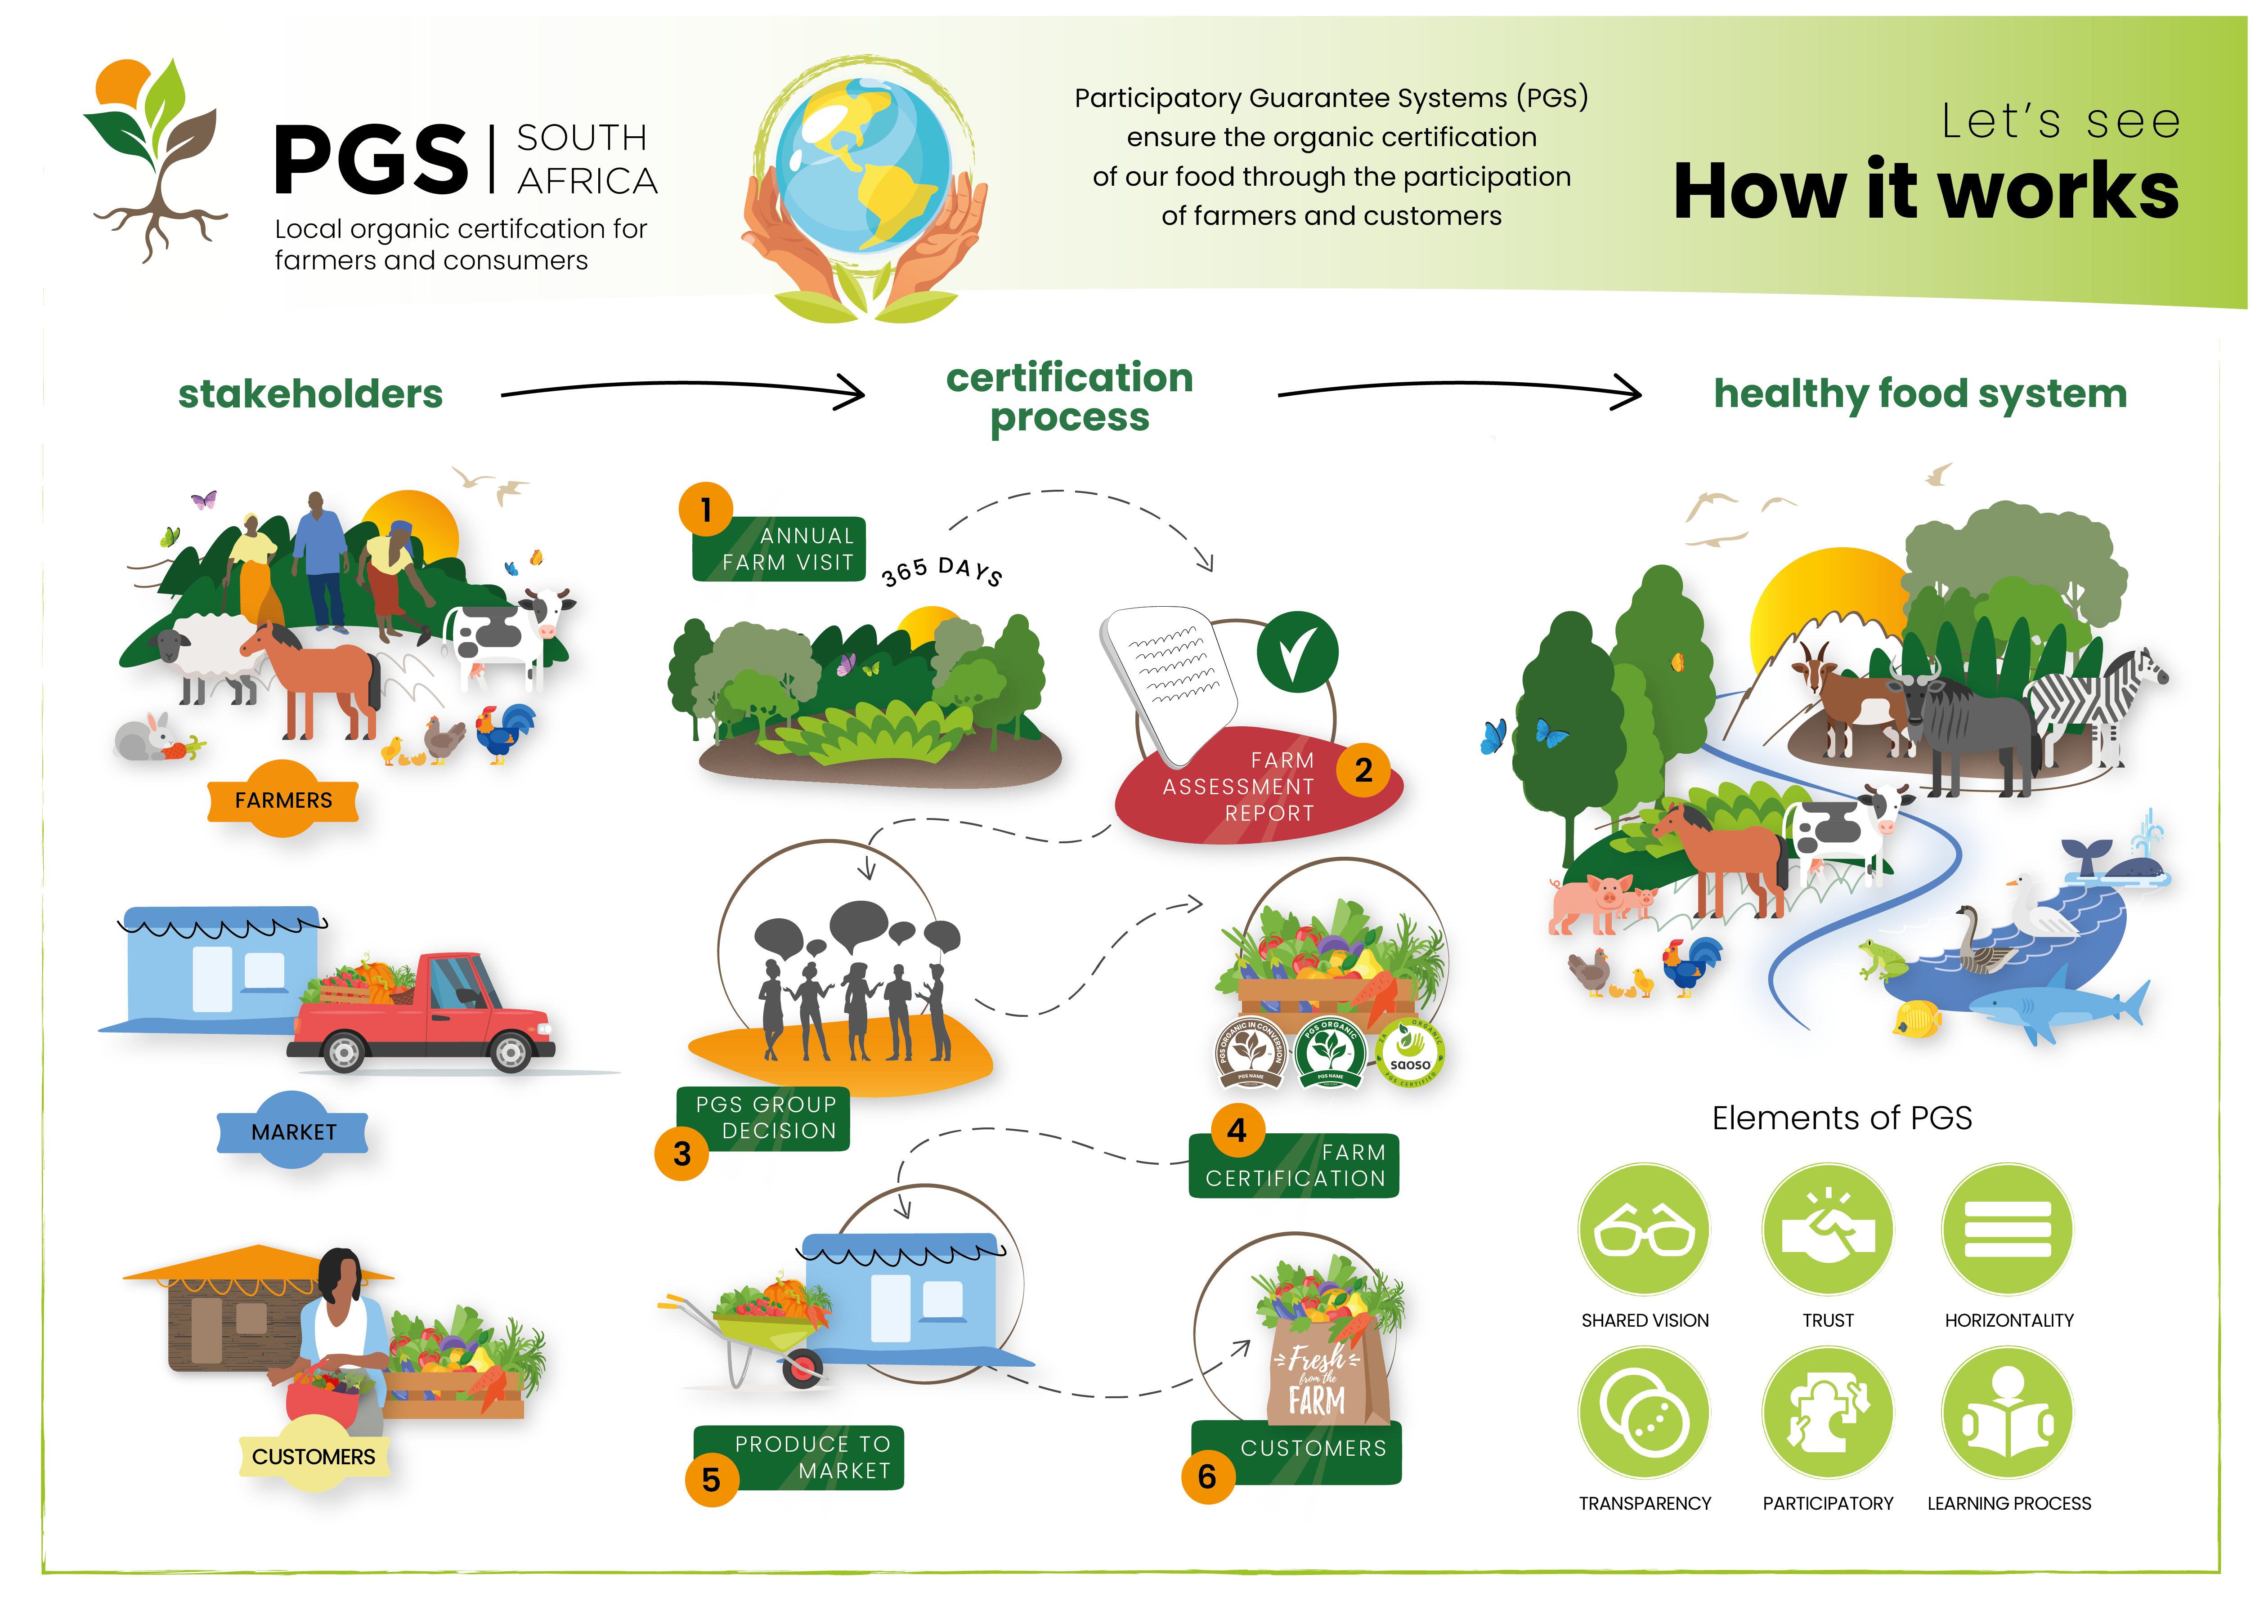
Notes:
Brett
So how does PGS work? Talk to the graphic
PGSSA –
- Support PGS groups decisions on standards and procedures
Oversite on assessment decisions
Approval of the groups
(Maintenance of central documentation – to follow )
Logo management
External relations

Slide 7
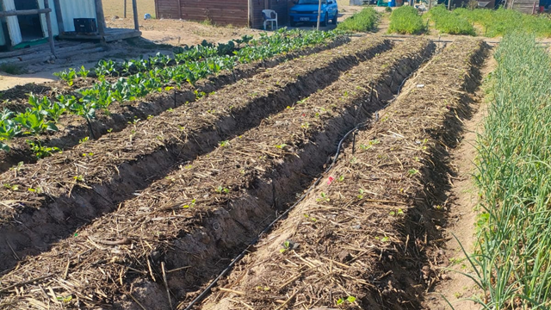
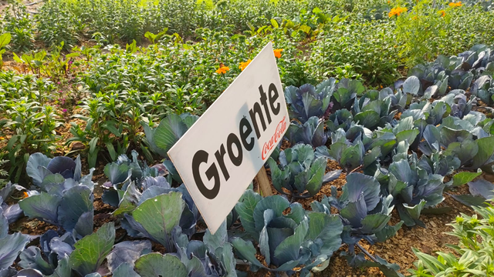
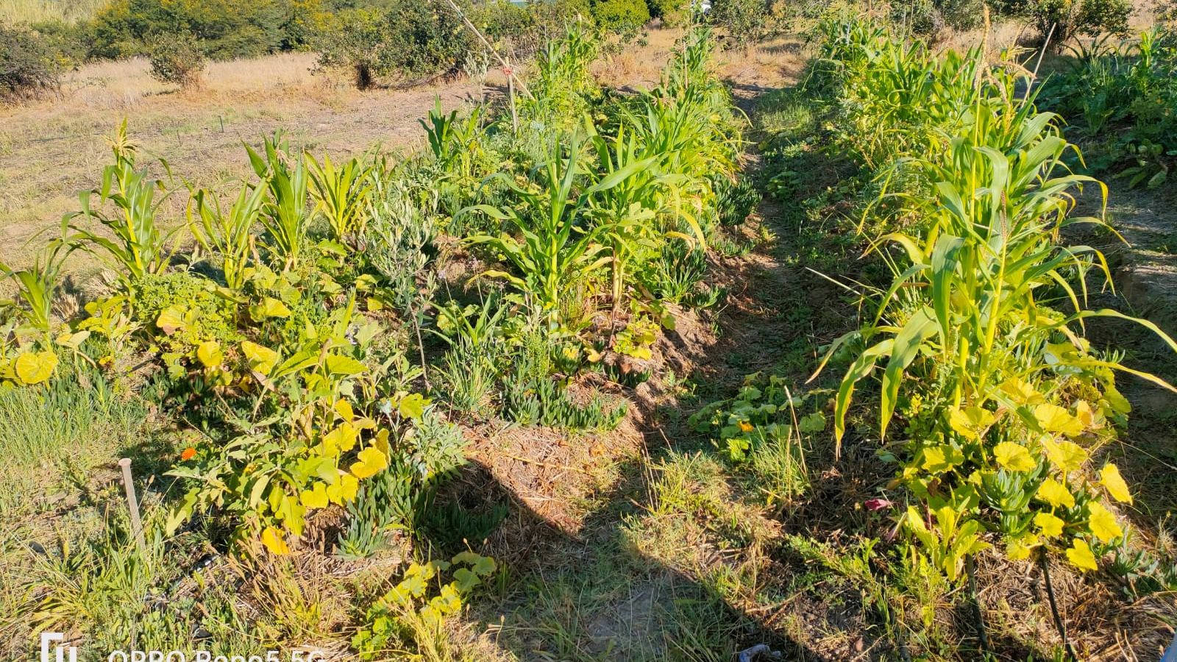
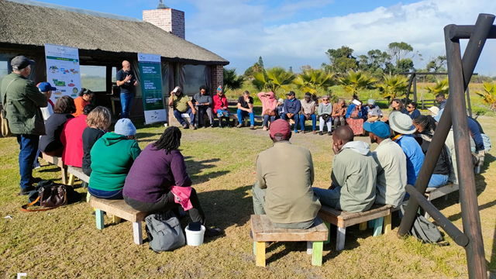
Results take consistency

Slide 8



Step 1
Farmers wanting to produce organically, and sell their surplus to a local market where there is consumer demand for organic produce, get together to form a PGS group.
Step 2
The PGS group agrees on their operational procedures and the standard against which farmers are assessed. The members sign pledges and formally establish themselves during a general meeting
Step 3
The group conducts farm visits, and if approved, issues certificates to its farmer members in the relevant category and farmers may label their products accordingly
=>use of two seals

Slide 9


Step 4
After18 months, interested PGS groups can apply to SAOSO and PGS SA for approval to use the SAOSO “PGS Endorsed” organic logo. in line with the requirements of Appendix 9 of the SAOSO Standard
Step 5
If approved by PGS SA the PGS group will be entitled to determine which of their farmers qualify for the use of the SAOSO “PGS Endorsed” logo – Mature PGS Supply chain and tracible = Agro Processing potential
Step 6
Any farmer who has been issued with the SAOSO “PGS Endorsed” logo and who wishes to be certified organic by a third party, would at this stage be considered as “ready” for third party certification.
Direct Third-Party
Option for organic farmer of part of PGS to be certified to the SAOSO logo through a certifying body
Notes:
sasha

Slide 10
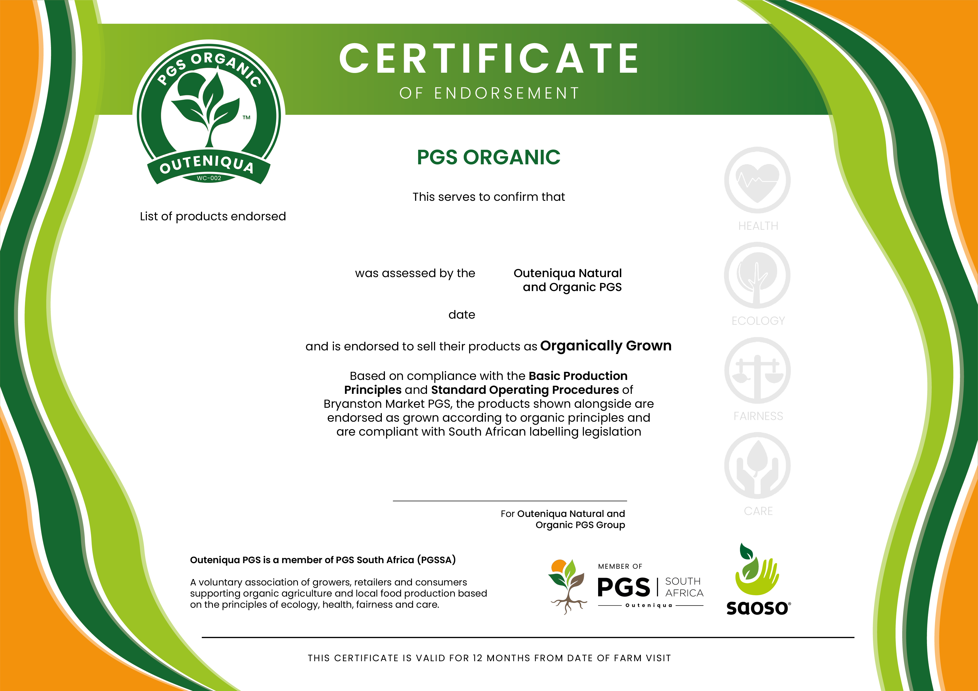
Notes:
sasha

Slide 11
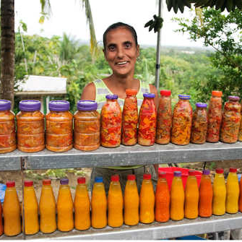
Technicalities with Agro-Processing in the PGS value chain
Most farmers that are agro-processing surplus have an aggregated value chain.
Some of the aggregated value chains are sourcing uncertified or conventional grown produce = Risk without clear batch codes and traceability.
PGS groups that are advanced enough for agro-processing. Capacity is limited to PGS certify complex agro-processed products.
Sourcing certified organic inputs such as sugar, vinegar olive oil ect are difficult to source in many rural settings.
Raises the cost of the product and requires premium pricing that is often too high for community and informal markets.
The formal retail value chain holds the most economic potential for PGS groups and agro-processed goods, which brings the debate around formal retail and PGS certification being robust enough for long supply chain and large retail.
Food safety certification is also a necessary aspect to ensure consumer safety and lability of a PGS group.

Slide 12
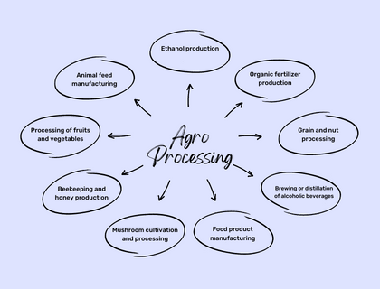
Finding the Middle Ground in PGS Agro-Processing
Focusing on step processing of fruits and vegetables.
Dried fruits, grains, vegetables and herbs
Chopped/spiraled vegetables and mixed salad packs
Food preservation – Olives, brined vegetables and pickles.
Cold pressed juices.
Basic products with less that 5 ingredients – Soup Mixes, Chuntnies, Sauces.
Nut butters
Dairy – Yoghurt
The technical capacity must be developed in the PGS group to be able to do a rigorous assessment of processing facilities, food safety and ingredients in the products.
POTENTIAL FOR AGRO PROCESSED GOODS IN THE PGS VALUE CHAIN IS SIGNIFCANT = JOB CREATION & LOCAL ECONOMIC DEVELOPMENT

Slide 13
SAVC- Aggregation
Value Chain + traceblity

Slide 14
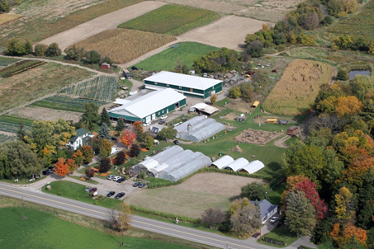
AgriHub - Purpose
  Manage projects and programs
  Facilitate growing operations with PGS Groups, co-operatives, communities and commercial operations
    Extension services, education & mentorship
    Inputs and seeds
    Equipment
    Research
  Facilitate socio-economic development
  Establish and operate agro-processing facilities – packhouse, manufacturing, etc.
  Facilitate supply chain operations to market
  Provide AgTech services

Slide 15
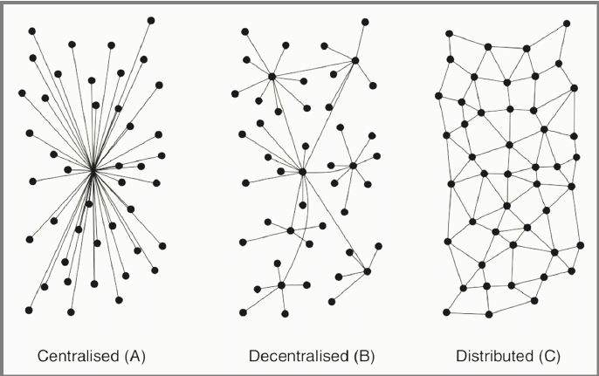
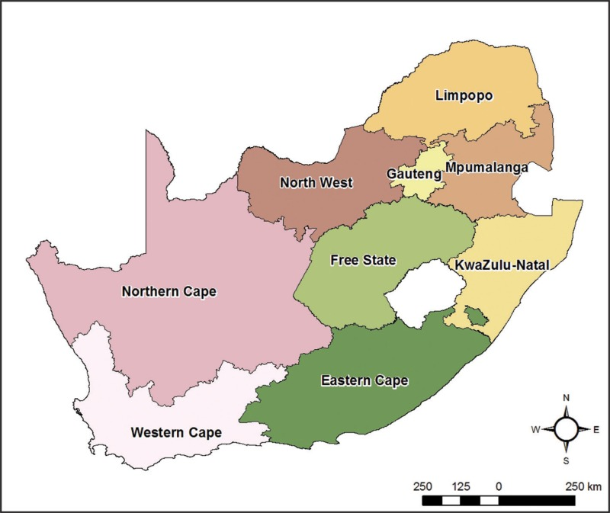
Food System Evolution 2021-2030

Slide 16

Website: www.pgssa.org

