Slide 1



PGS groups and the certification of agro-processed produces : TOAF PGS
Jintana Indramangala
Thai Organic Agriculture Foundation
19 August 2023, At webinar organization by PGS SA and PGS Ghana

Slide 2
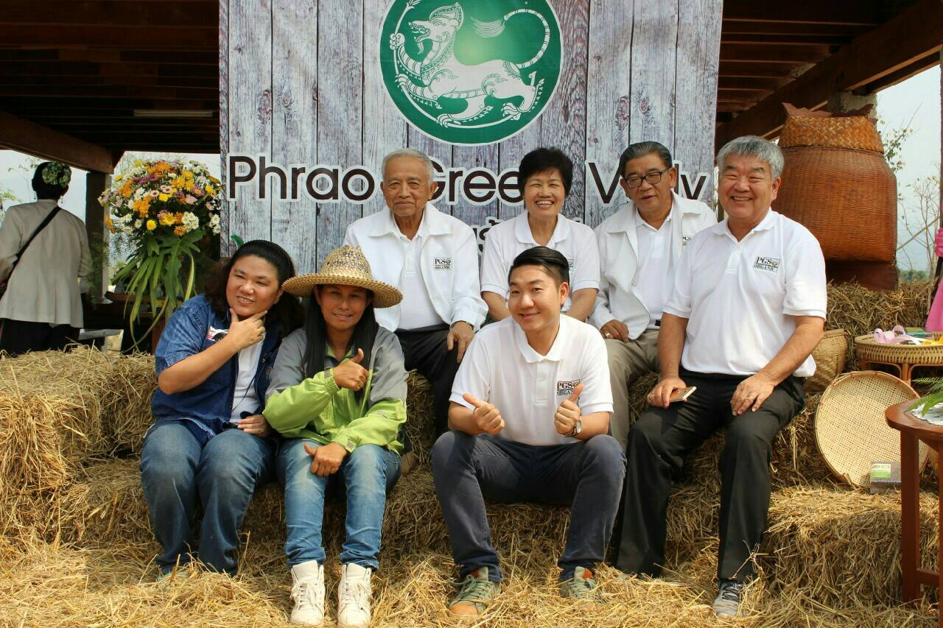
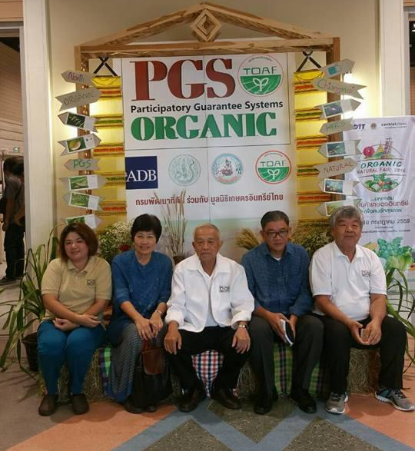
WHO are we?
Getting started with TOAF-PGS

Slide 3
Thai Organic Agriculture Foundation, TOAF
Established since 2012,
Founder by experienced official in organic agriculture from government agencies, universities, private sector, farmers, etc.
we are non-profit organization,
major objective is focusing on center of coordination of all sides concerned including research and development of organic agriculture.
Collaborate and link among gov. agencies, private sectors and farmers in organic PGS movement.

Slide 4
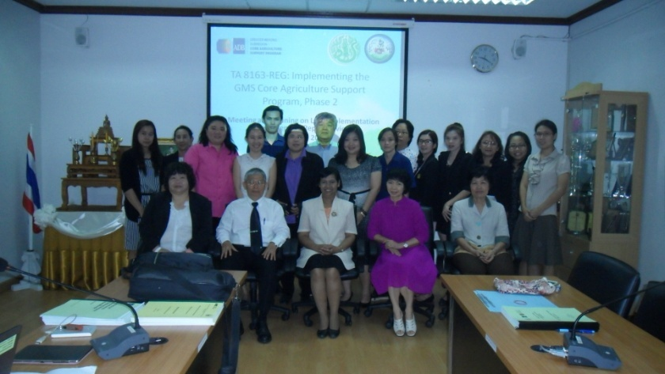
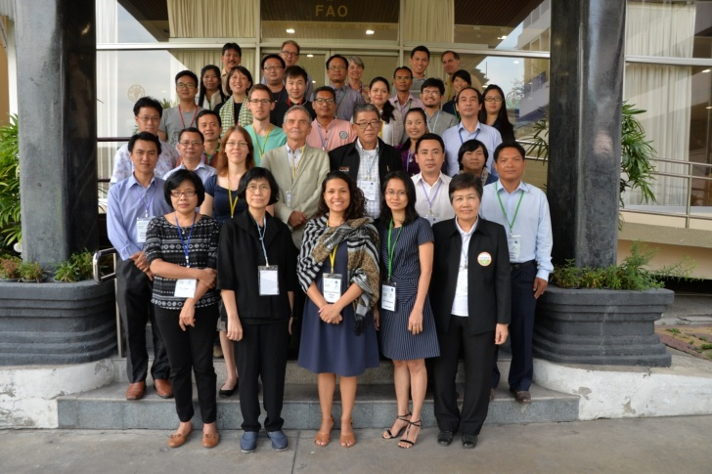






How to develop PGS in Thailand
During 2015-2016,
ADB and MOAC by Land Development Department, LDD incorporated with Thai Organic Agriculture Foundation, TOAF launched the project : Promoting Participatory Guarantee Systems (PGS) for small scale organic farming in Thailand :
To explore and develop PGS as a means of organic guarantee for local consumption in the Greater Makong Subregion
To set up 5 demonstration PGS initiative groups
To understand how the PGS system work

Slide 5
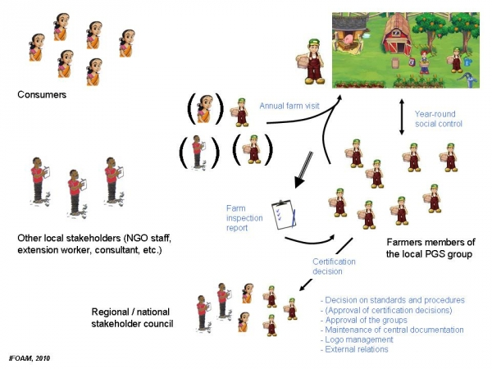
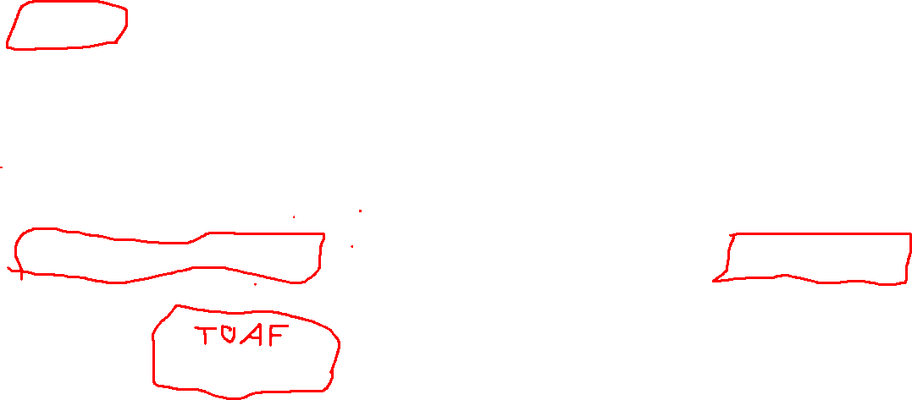
PGS
Multisectoral collaboration

Slide 6
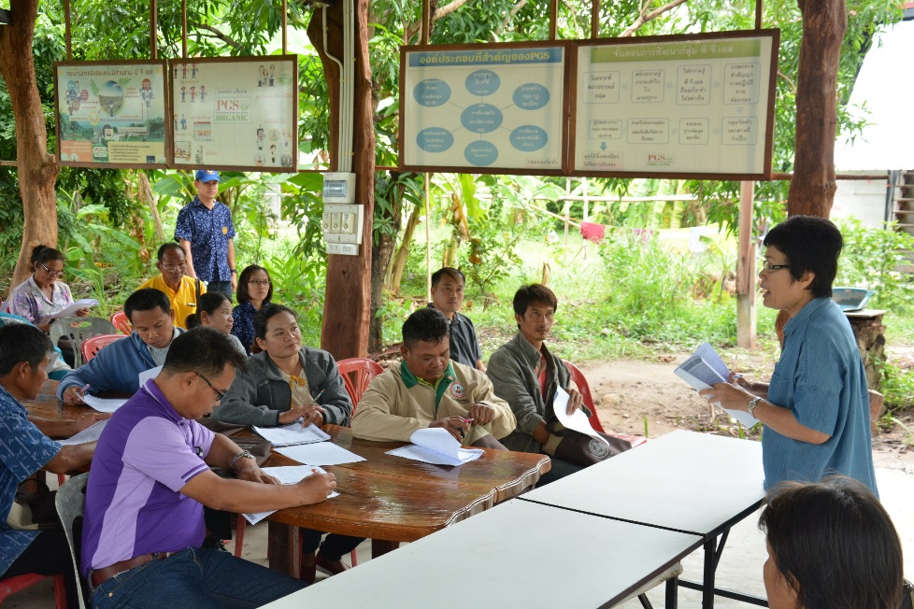
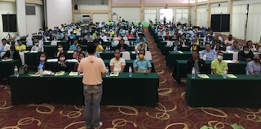
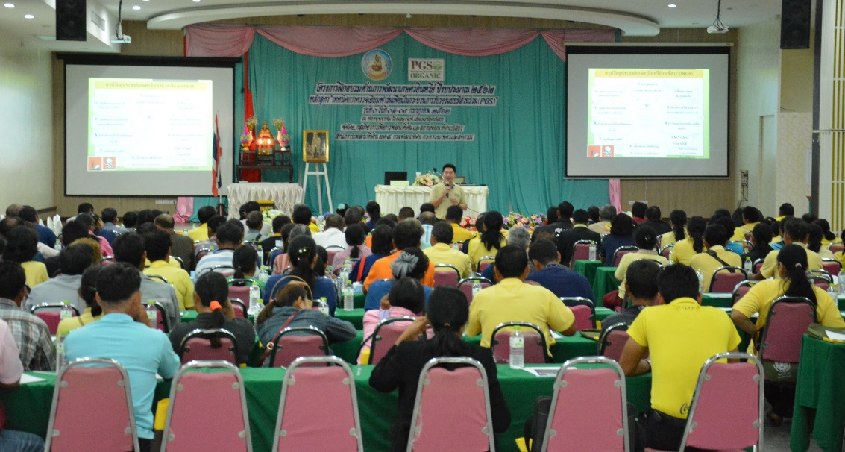
Technical assistance and Training courses
Provide training courses
Assist, follow up and monitor PGS group forming process
Organize PGS process, approve the groups certification

Slide 7





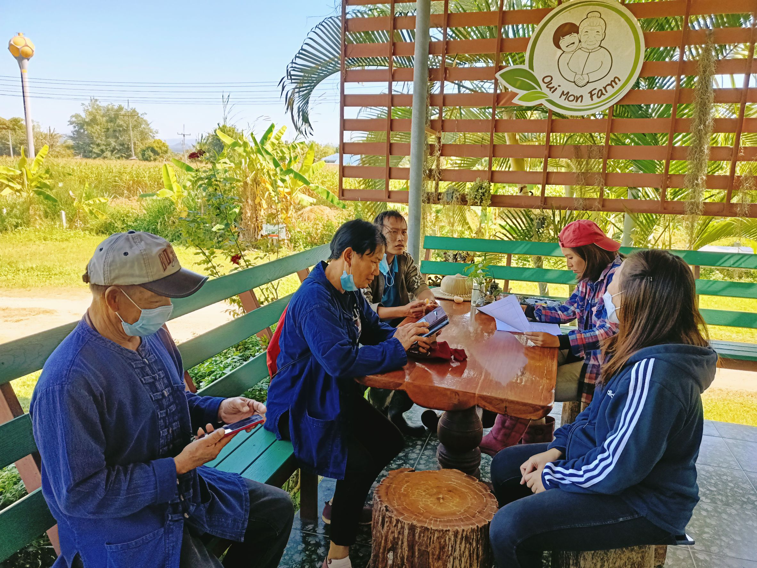
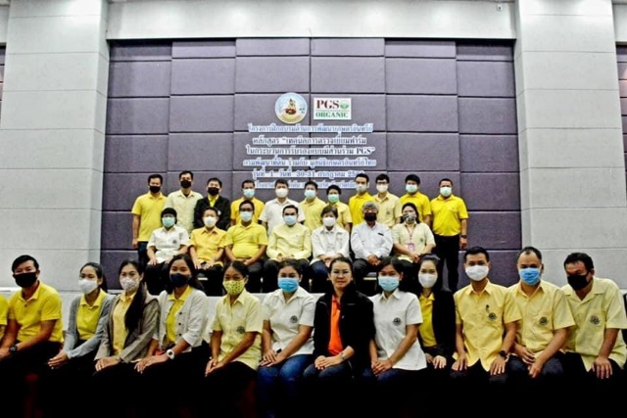
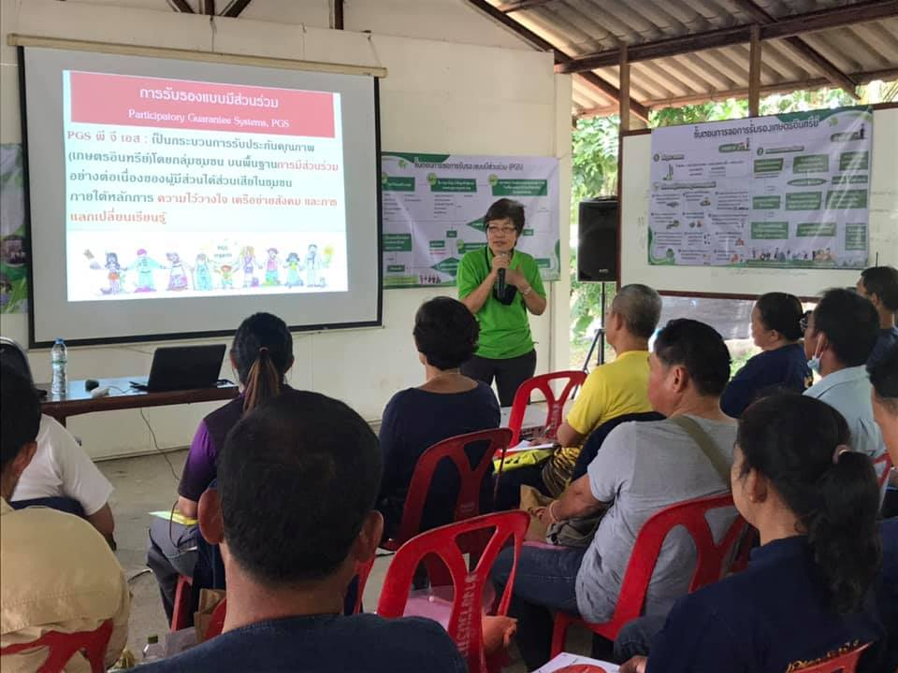
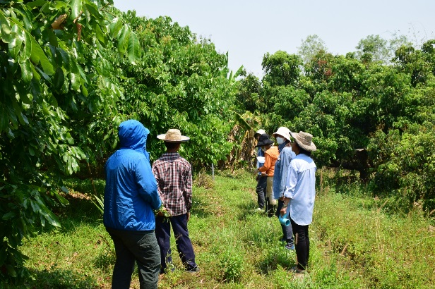
Thai Organic Agriculture Foundation
Supported organic movement
1. Training Local government officials to be as facilitators of produce groups
2.Training group’s leaders how PGS work and how to manage the groups
3.Training volunteer farmers to act as organic farm peer review.
4.Monitoring
and evaluating at group base.
Training
For The Trainer
Master and coordinator
Peer reviewer
Monitoring & coaching

Slide 8
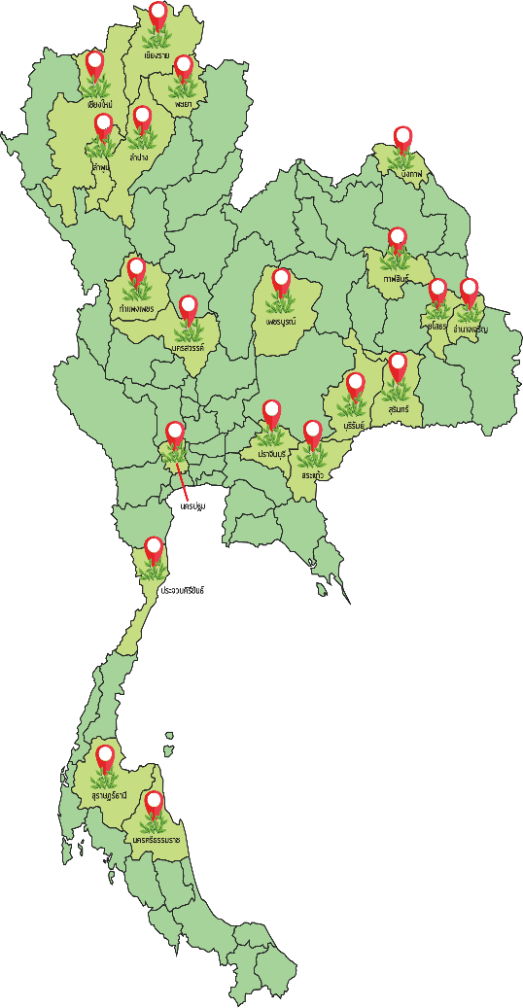

Impact of PGS Project for 5 yrs.
Annually certified groups
25 PGS operational groups , 800 subgroups, 20000 farms/yr,
2000 certified farms/yr.22
Marketing channels
Local/domestic
Rice, vegetable, fruit, herb, coffee
Thai Organic Agriculture Foundation, www.pgs-organic.org, fb TOAF PGS

Slide 9
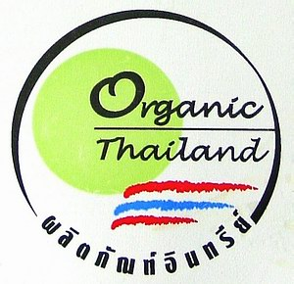
PGS key elements
TOAF PGS follow IFOAM PGS Guidelines, 2008,2019
PGS IFOAM key elements and features
Follow organic agriculture norms and adopted National Organic standard, Organic Thailand
Shared vision
Participatory
Transparency
Learning process
Trust
Horizontality

Slide 10
PARTICIPATION for Common Features of PGSs
Common features of PGS
Standards and NORMS
Pledges
Defined consequences
For
Non comply
MECHANISMS To verify producer compliance
Seals and Labels
Documented management syst. And
procedures
All stakeholders are clearly defined and cover voting rights

Slide 11

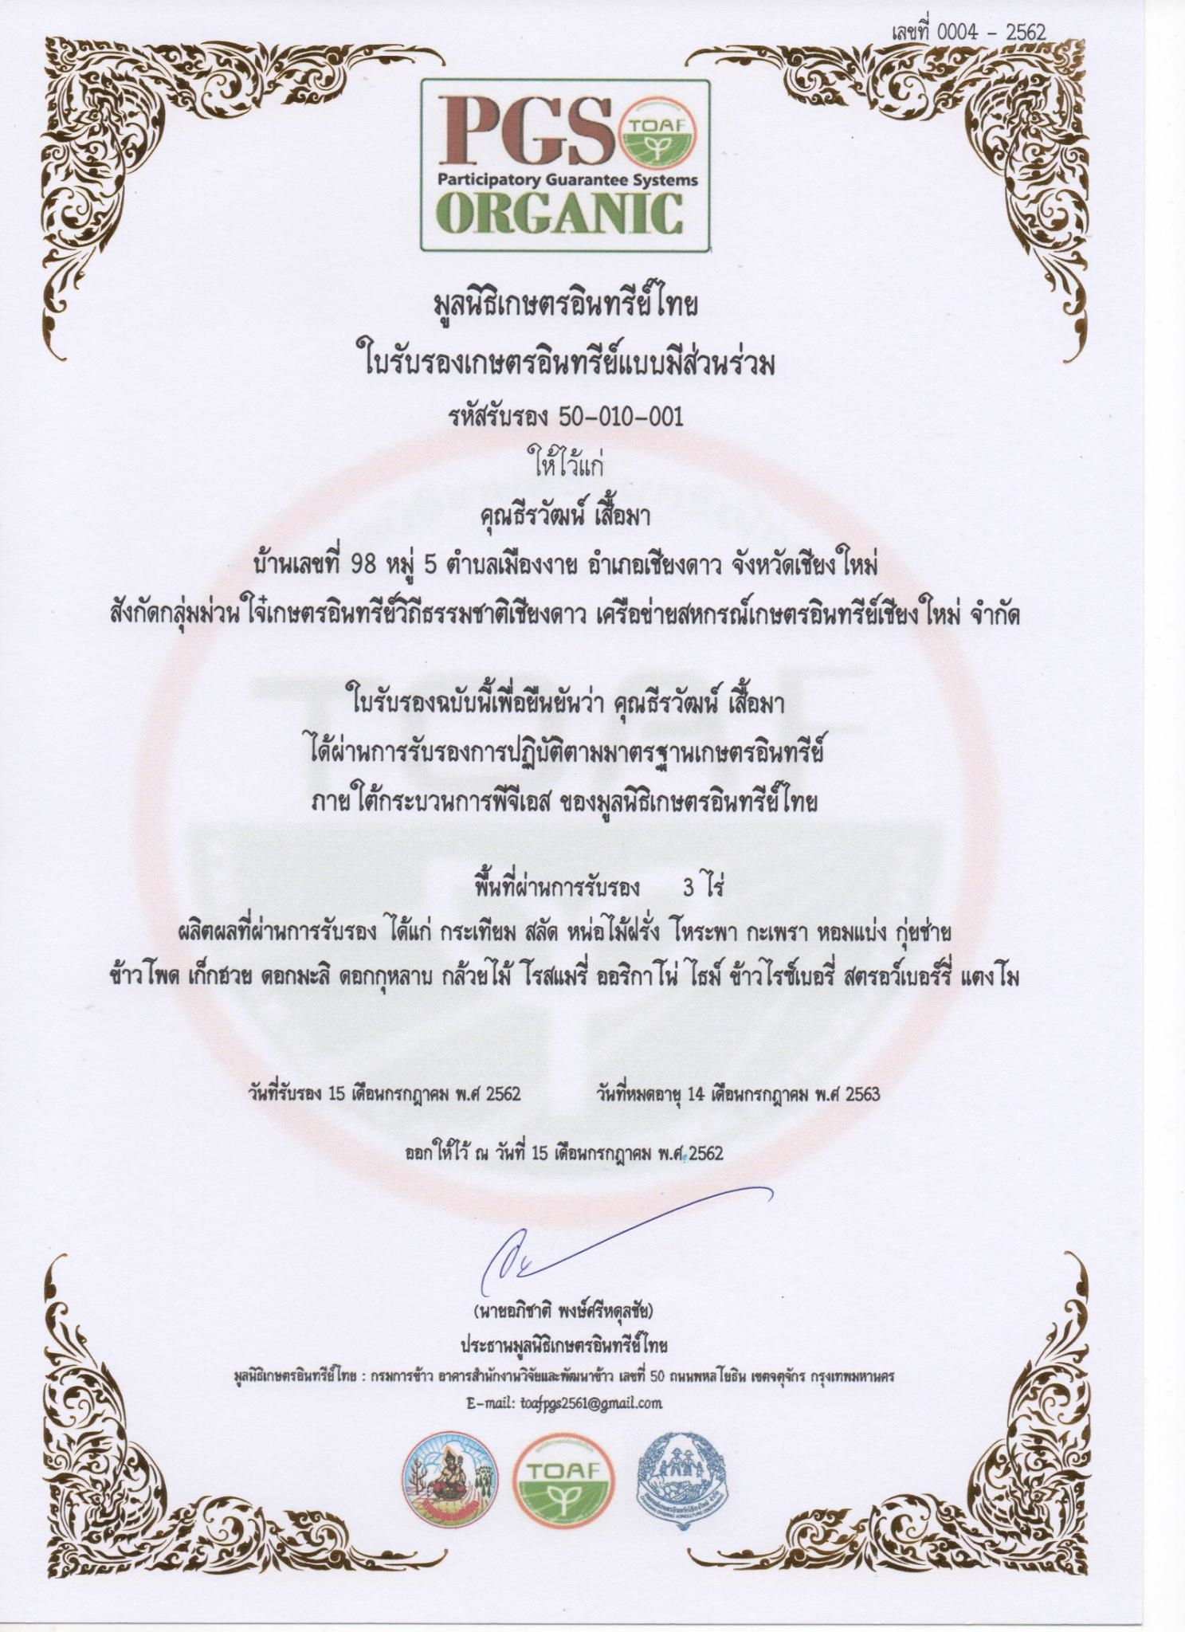
PGS Development Steps
Situation analysis
Build
Awareness
organic standards
Training in how PGS works and sign Pledge
Documentation (farm details - includes history and map).
F1-F6
PGS group database
Peer review (peer review checklist) Checks farmers records, inputs used and fields
Internal audit check documentation and approval/follow-up non-compliance.
Certificates
given out.

Slide 12
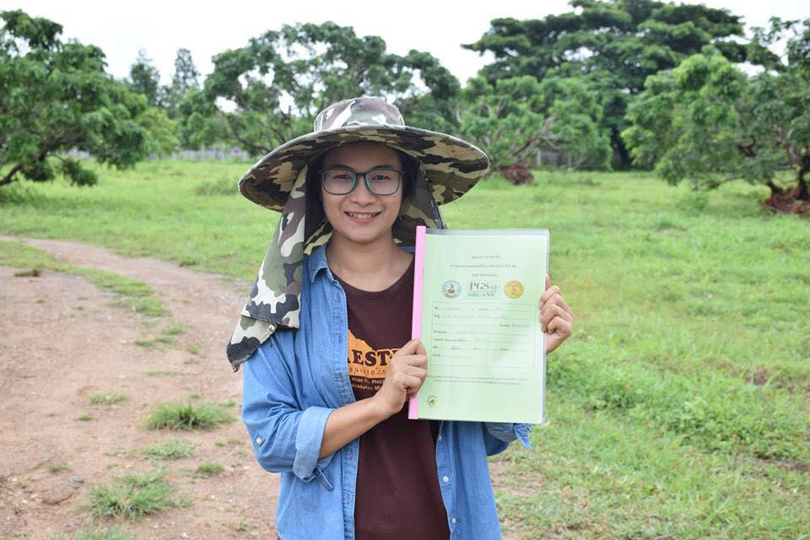
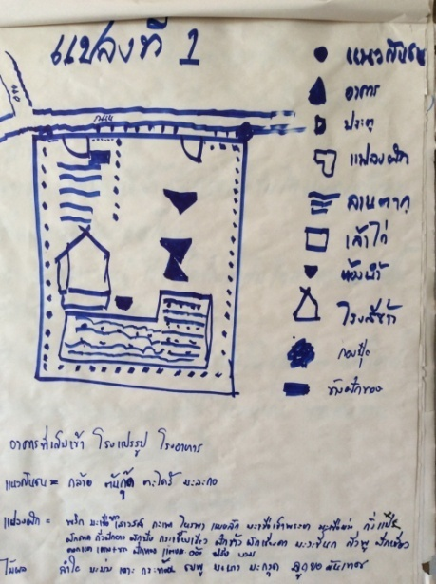
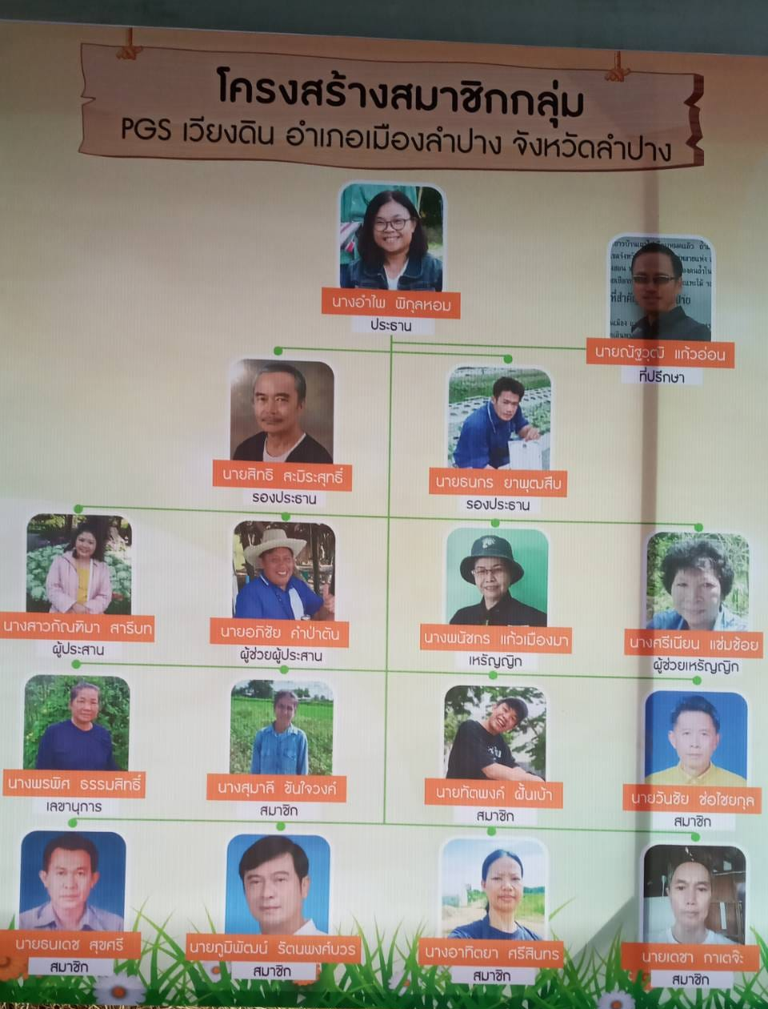
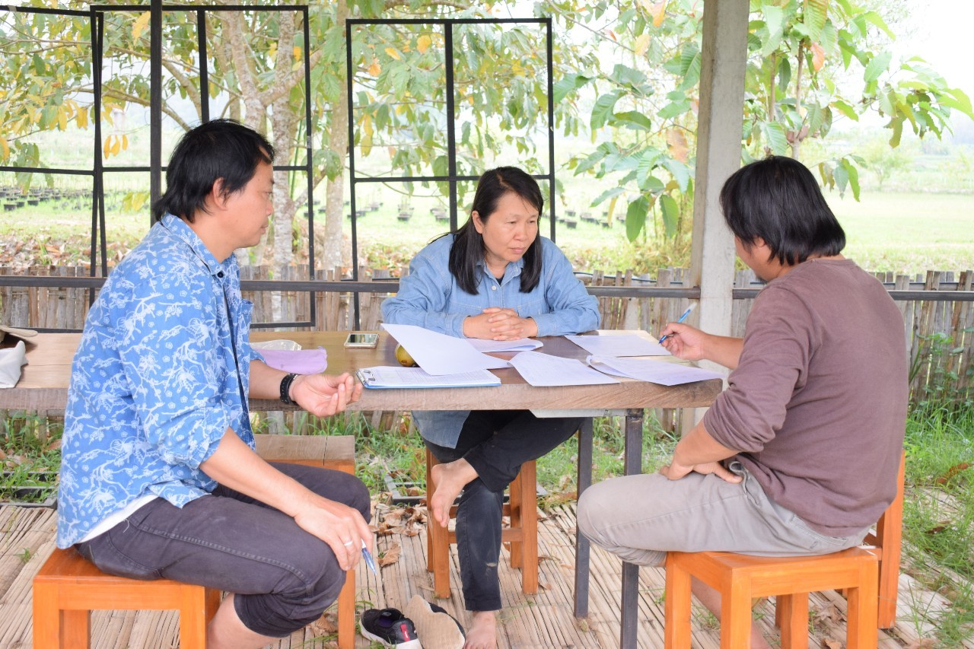
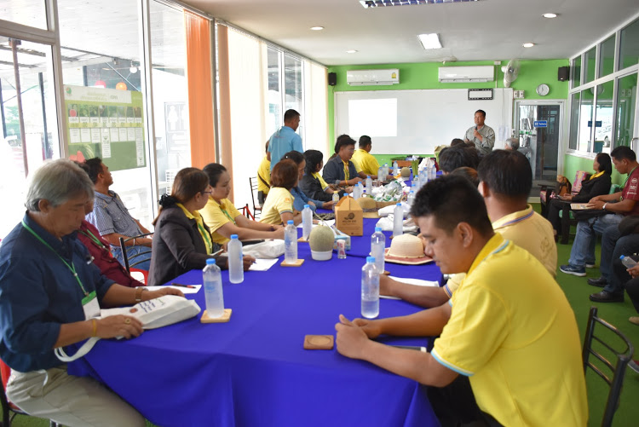
TRANSPARENCY
Clearly defined group structure and documented systems
Active participation of producers in activities of the group , meeting , peer reviews ,decision making etc.
Mechanism to certified farm
Open farm to all involve

Slide 13
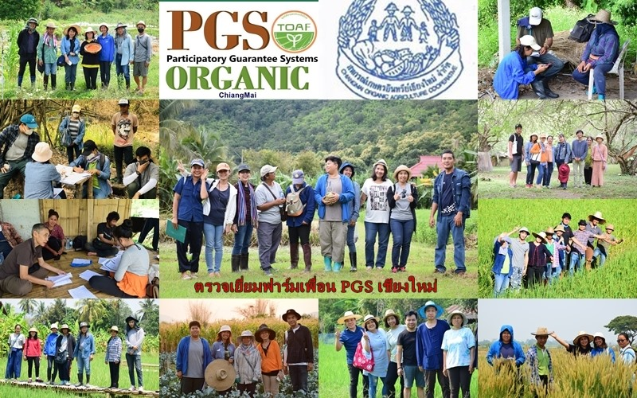
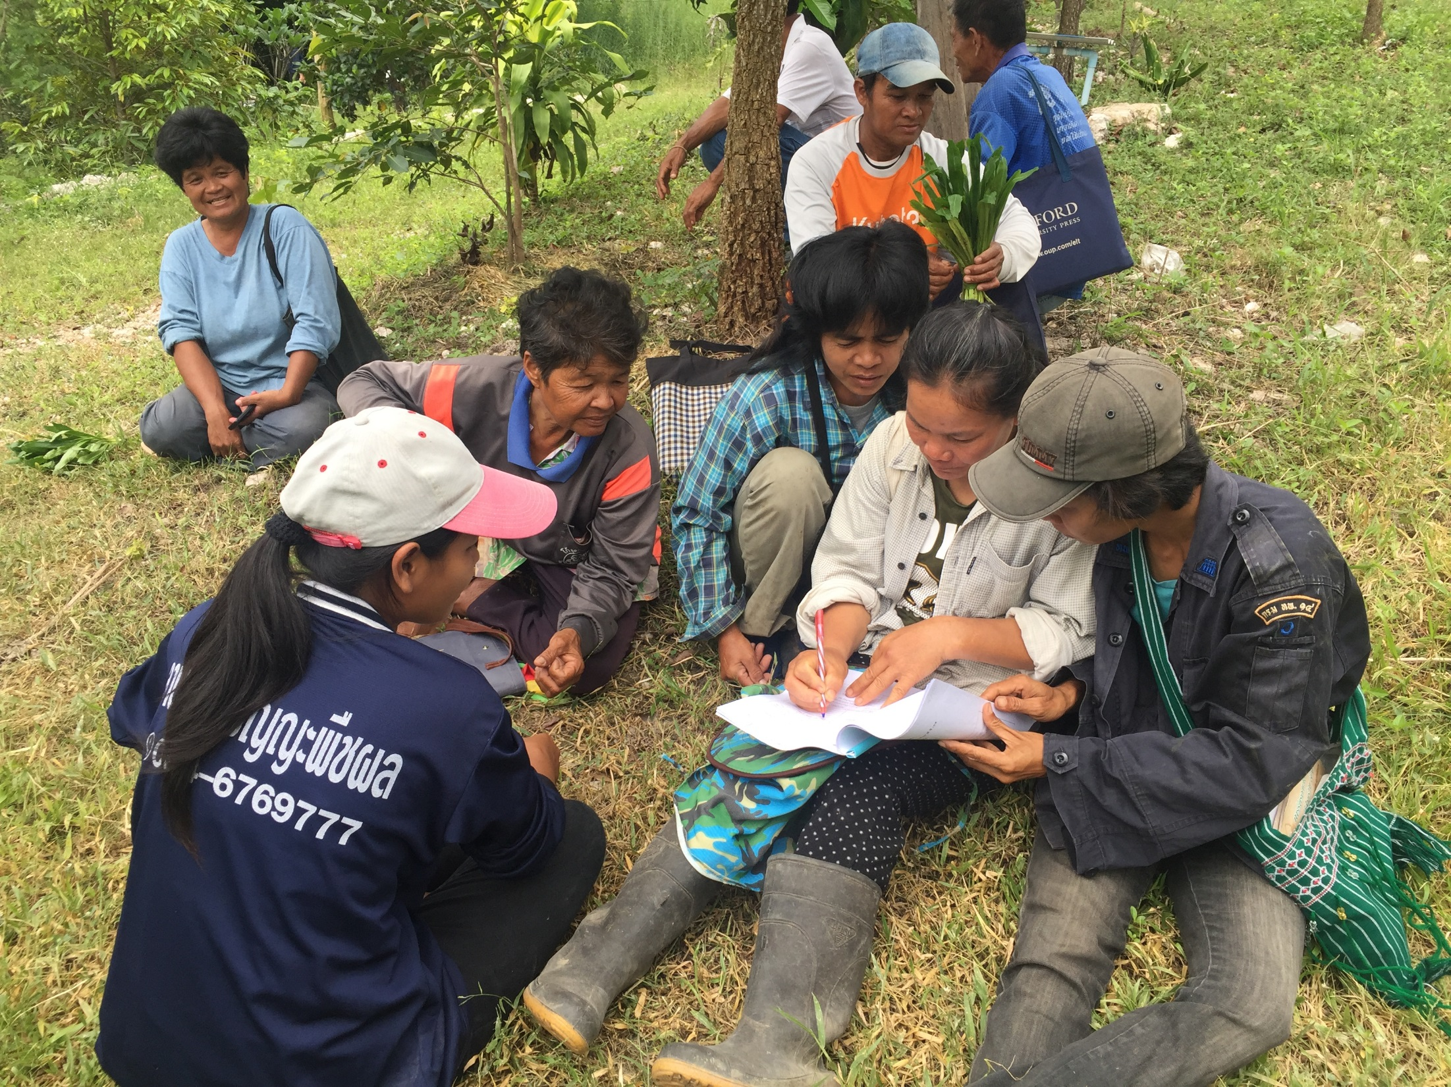
Focus on the Peer review process
It means that the quality control is not carried out by an external inspector but by the members of the same group, community, association.

Slide 14
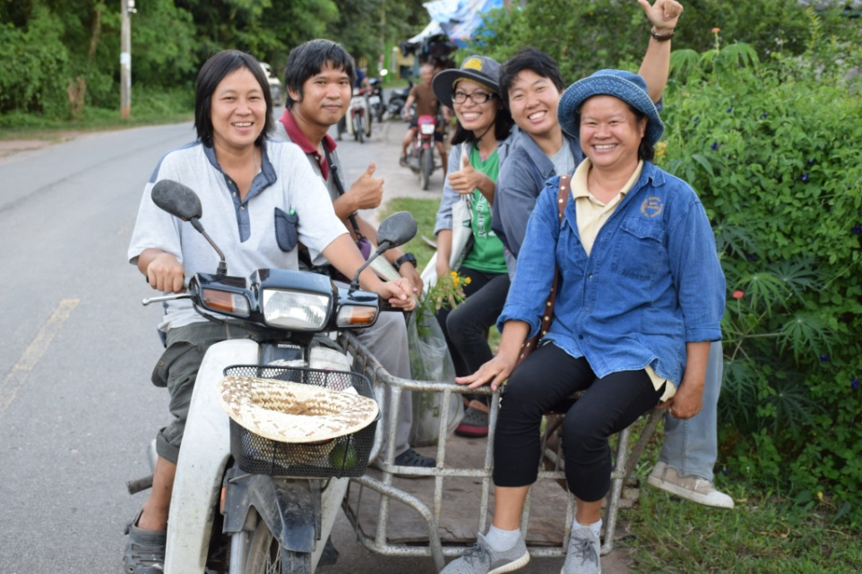
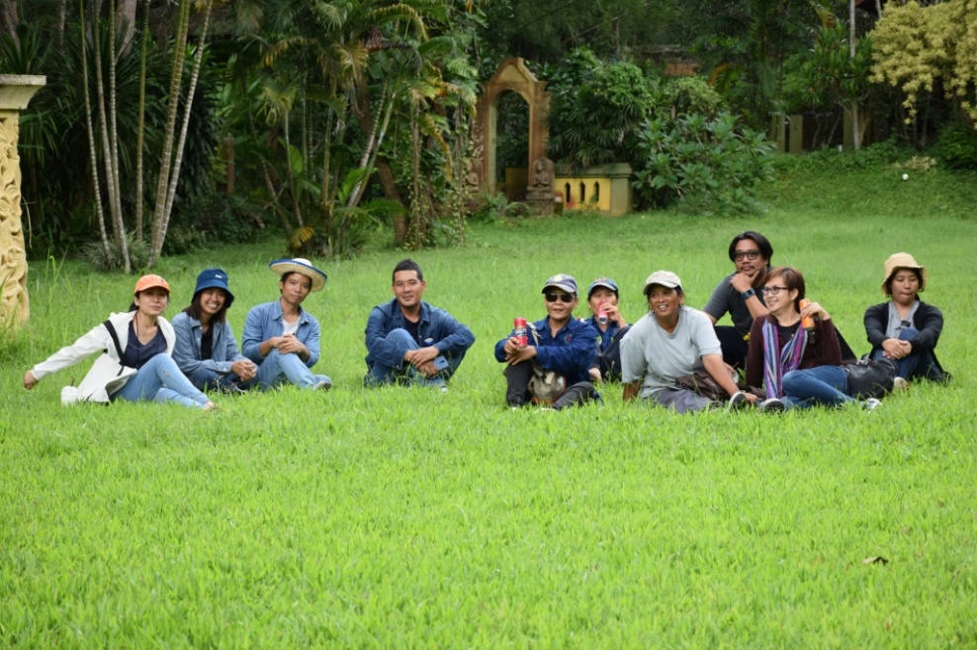
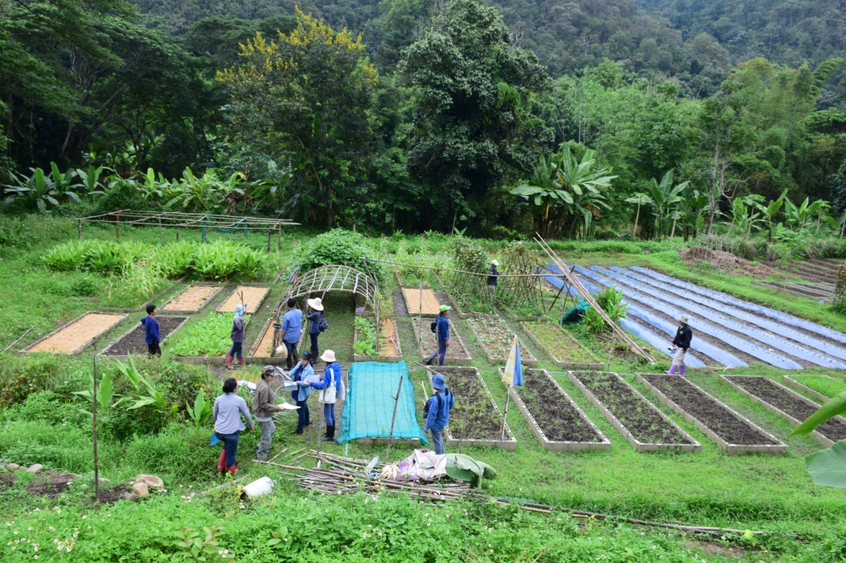
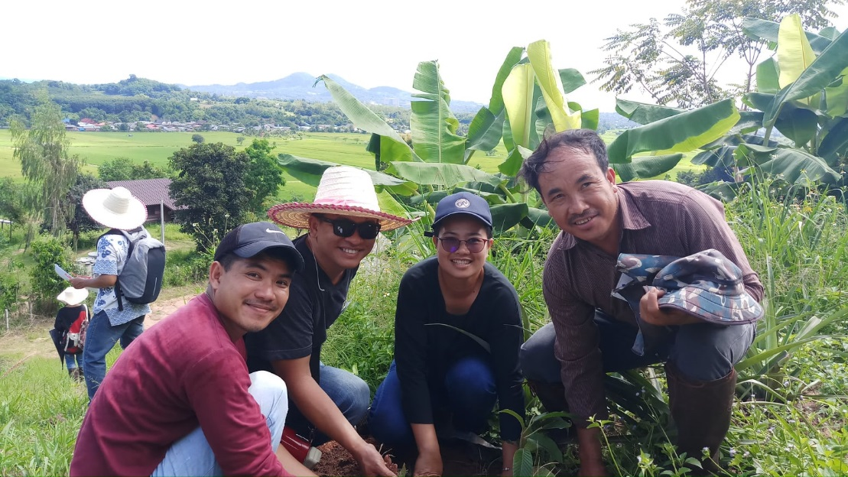
Good partnership & ownership

Slide 15
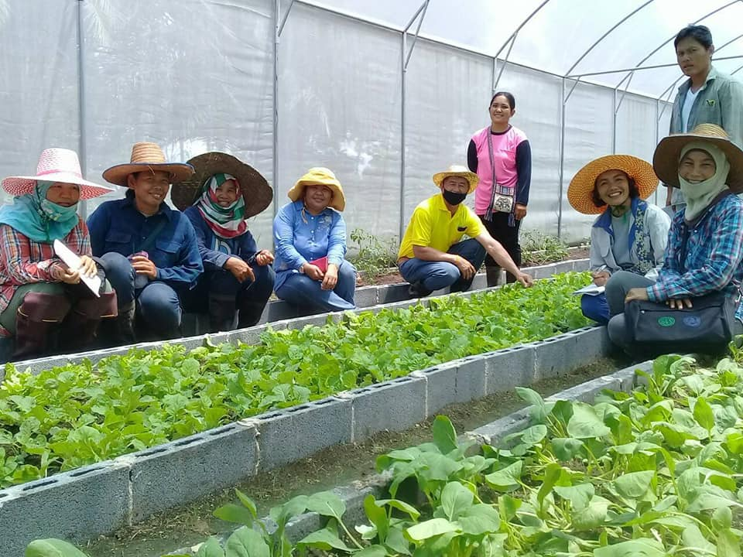
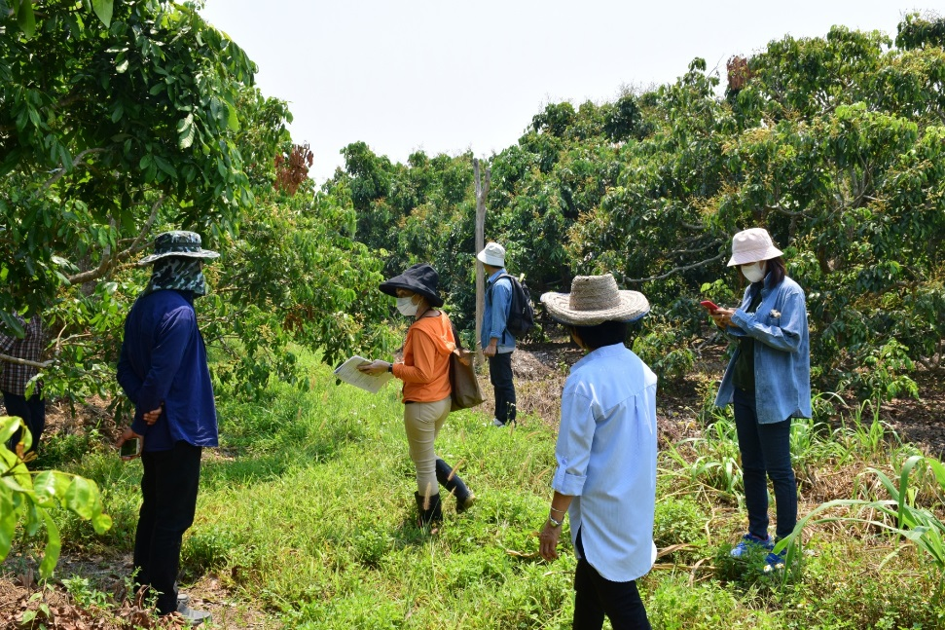
LEARNING PROCESS
Knowledge building /regular meeting and workshops to discuss technical and marketing issues
Include all producers in Peer review inspection of the other farms in order to sharing their experience

Slide 16
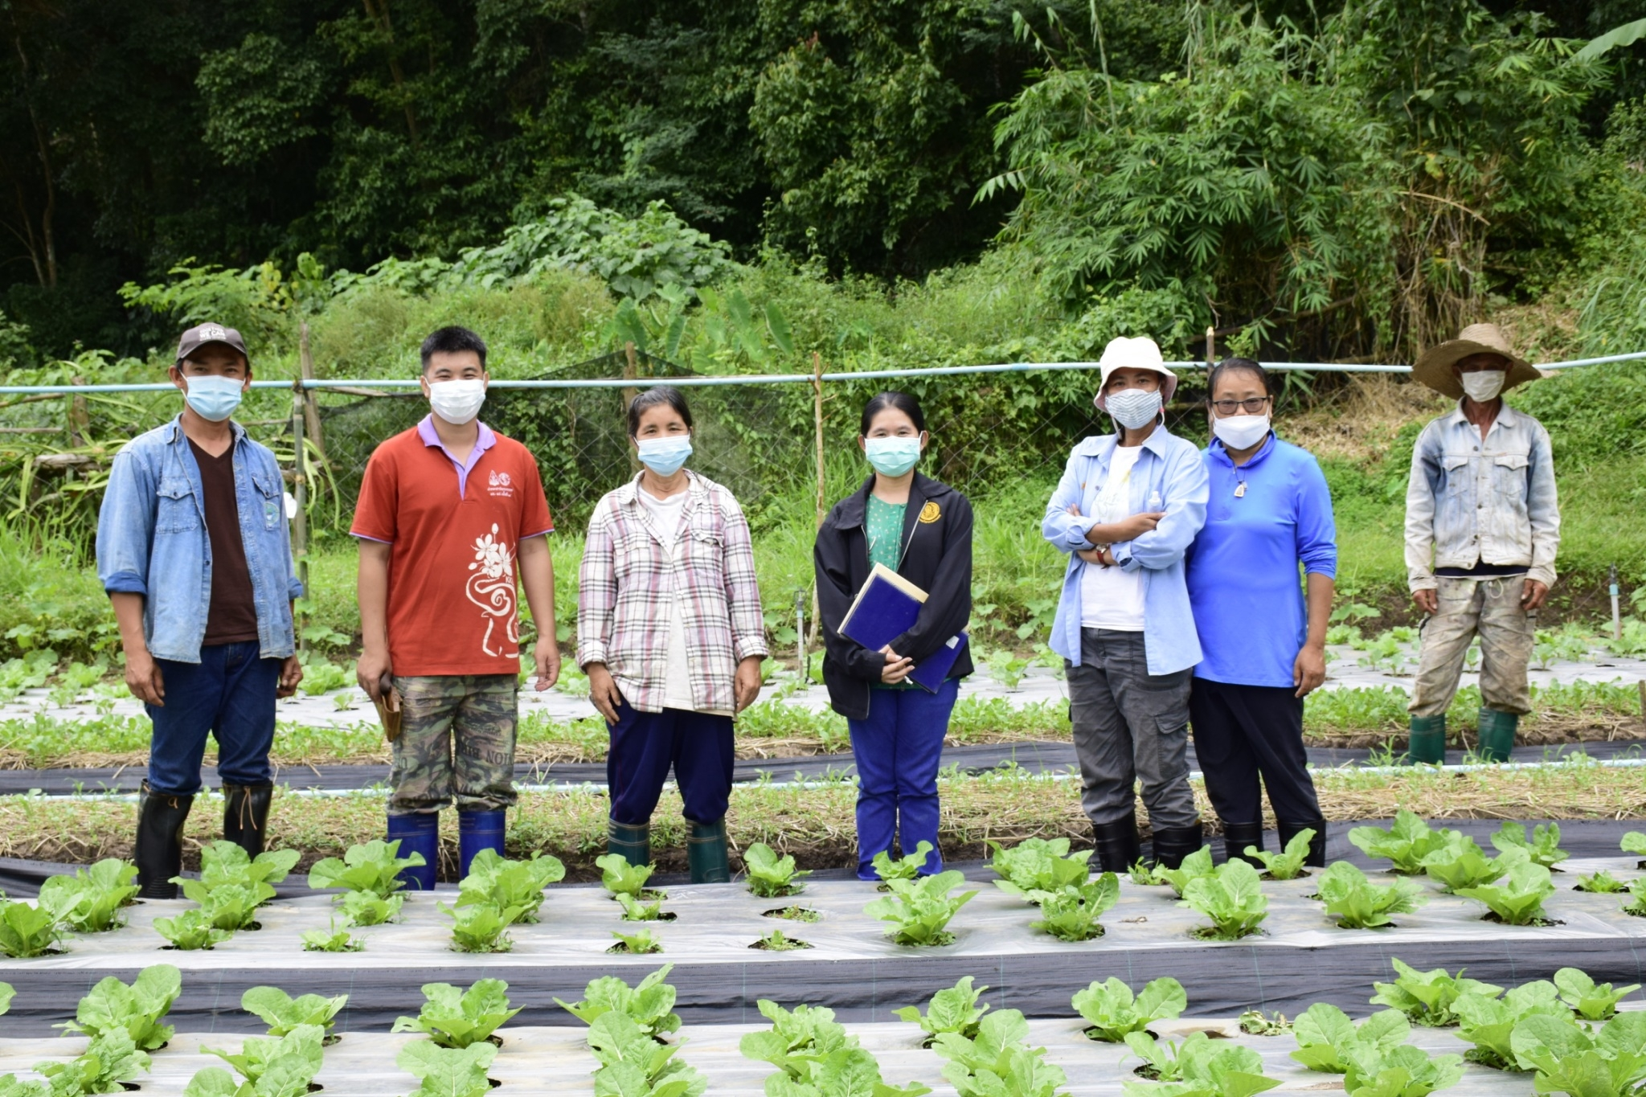
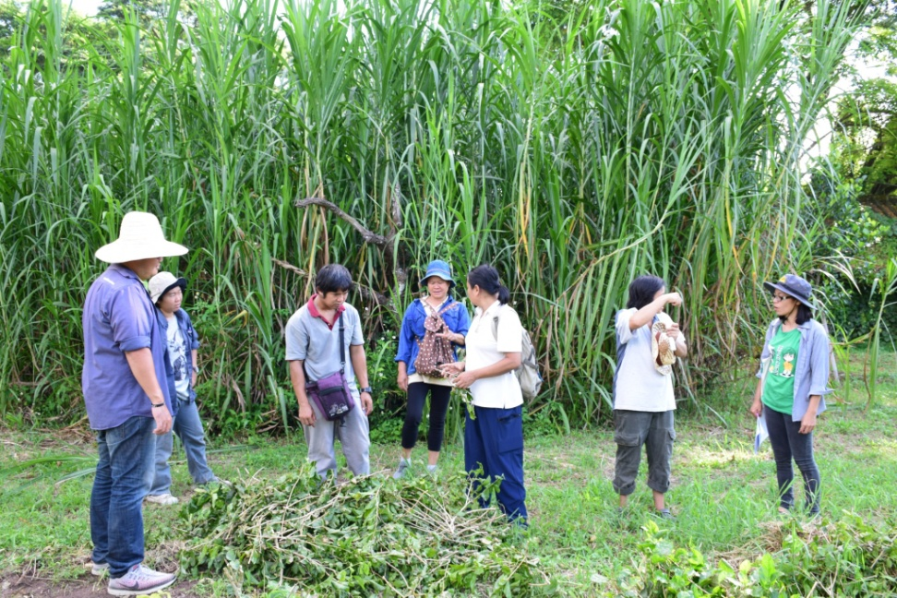
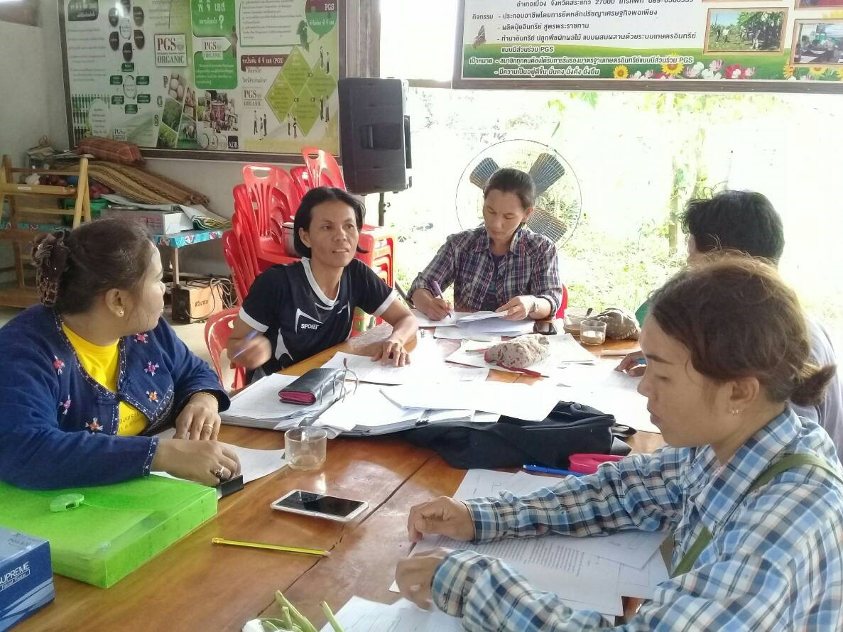
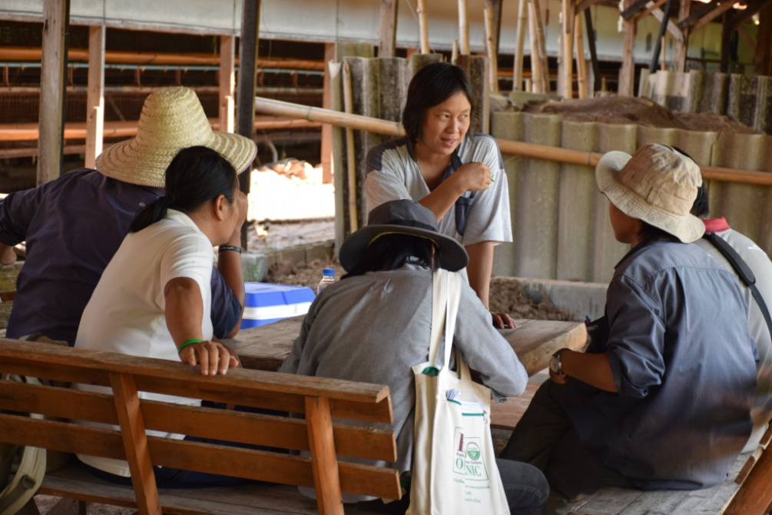
PGS group democracy &participation for decision process
Consensus group voting
to verify farmers
as organic farming
Grant certificate

Slide 17
Processing and Handling
Large scale
Small & medium scale
Homemade

Slide 18
Example of a PGS Operator Arrangement
PGS (operator)
Coordinating Group
Processing group
Farmer group
Company/Trader
Farmer group
Farmer group
Farmer group
Cooperative
Community enterprise

Slide 19
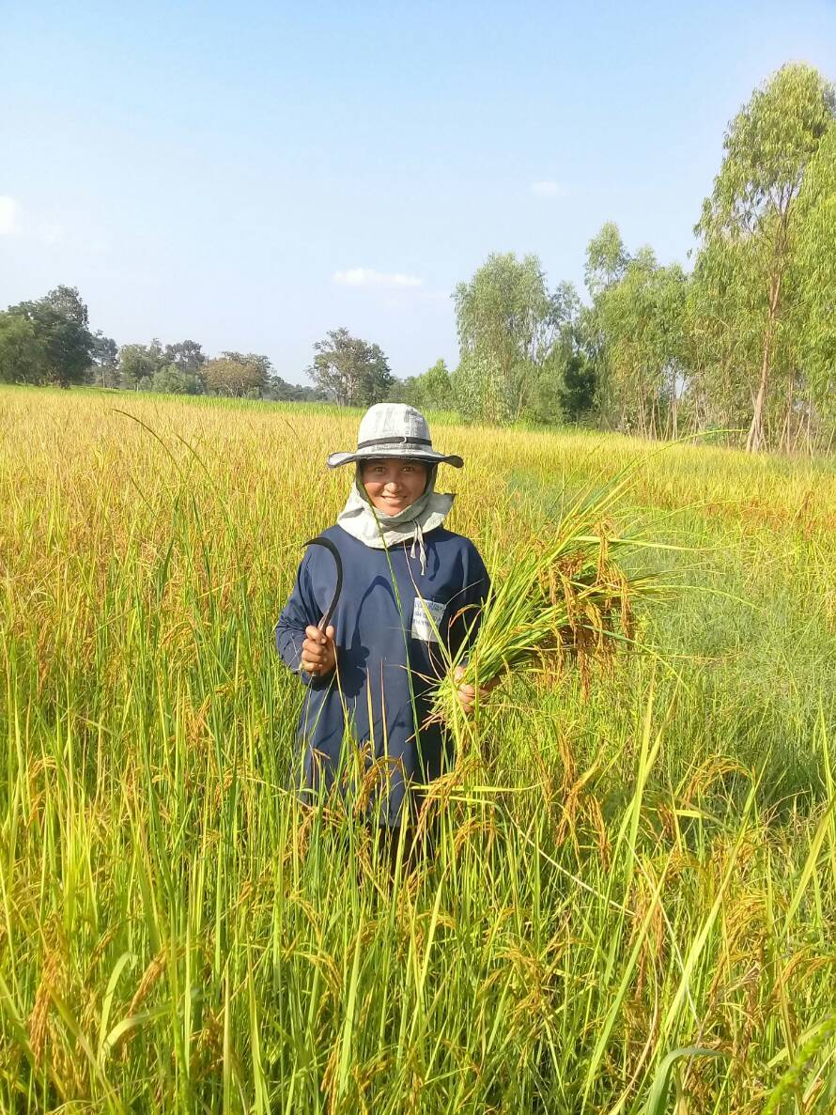
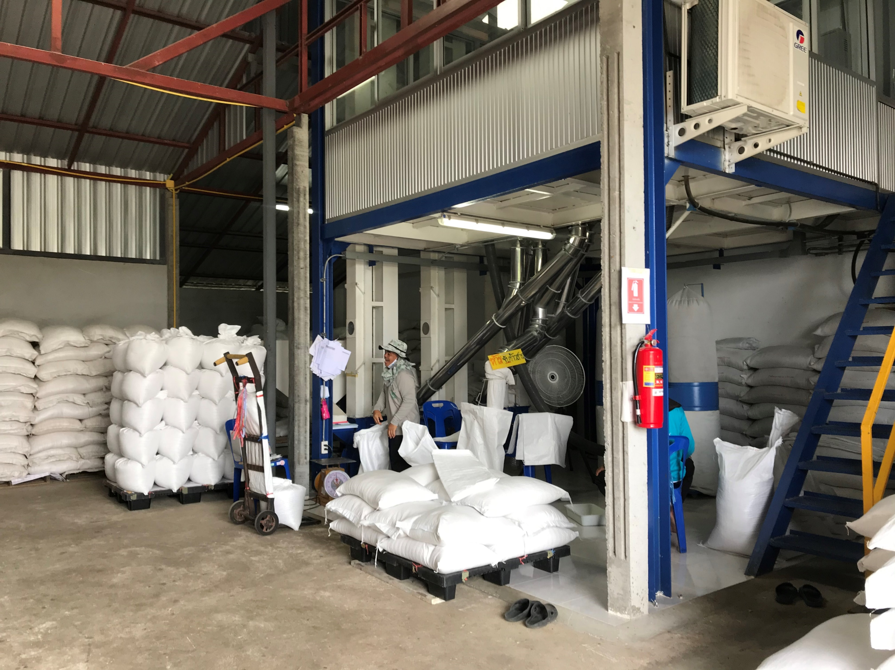

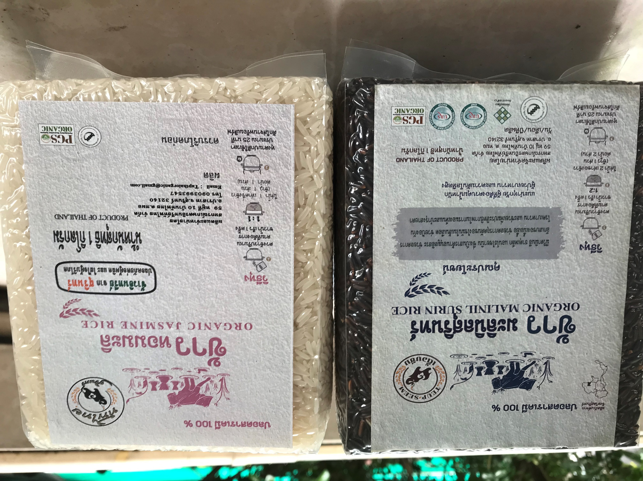
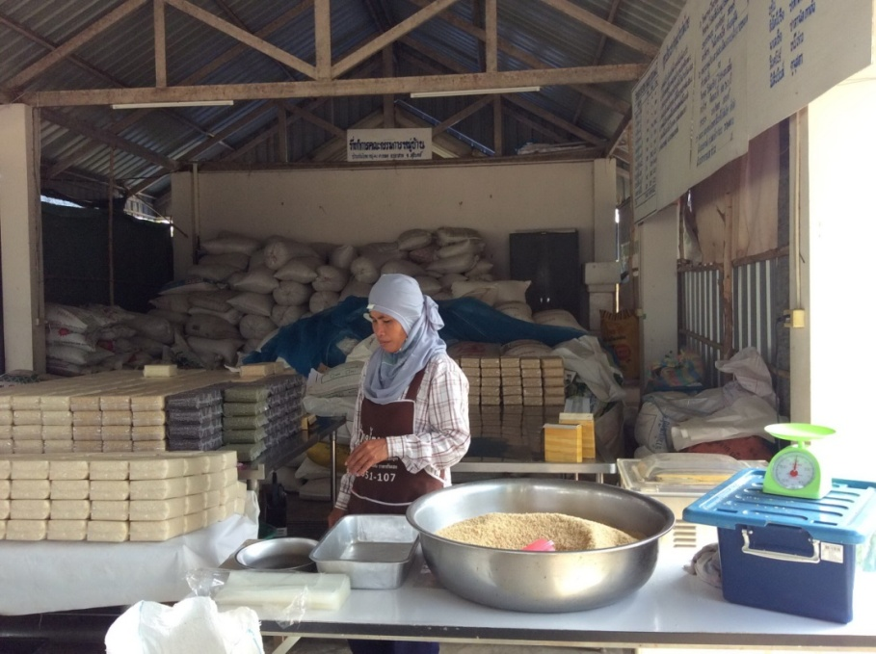
Rice Processing& Handling
rice gathering at farm
Organic PGS certified
Paddy field
Operator
Farmer groups
Paddy rice
Gather produces
Rice mill
packaging
GMP
Rice grain
Trader

Slide 20
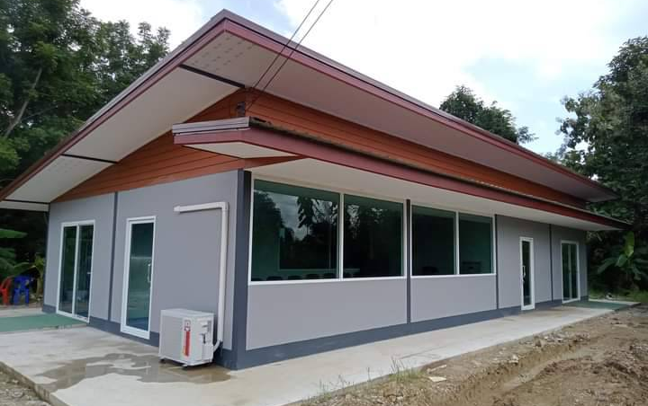
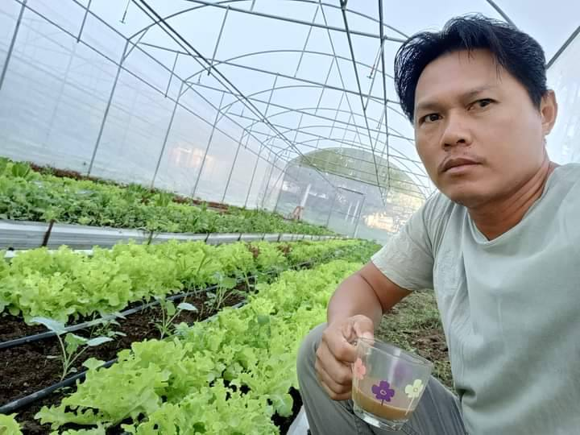
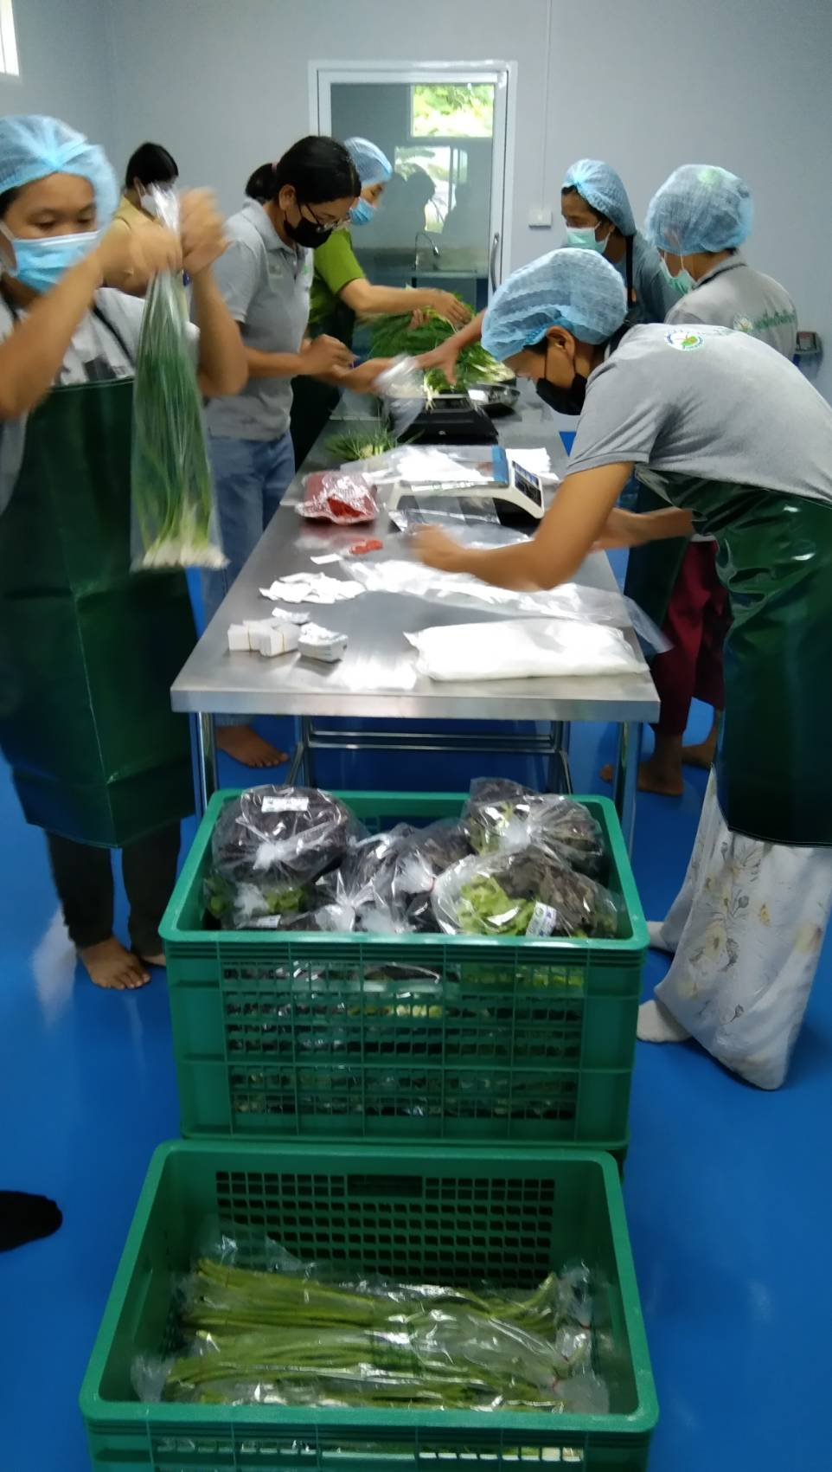
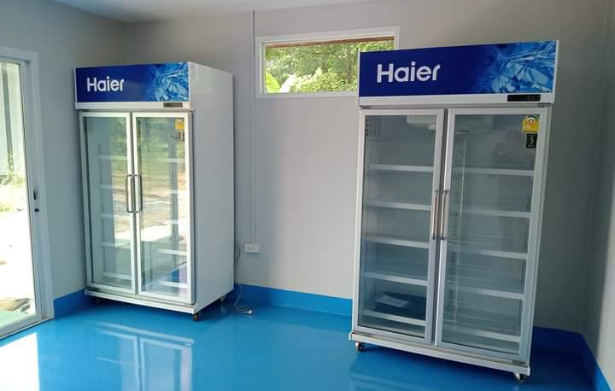
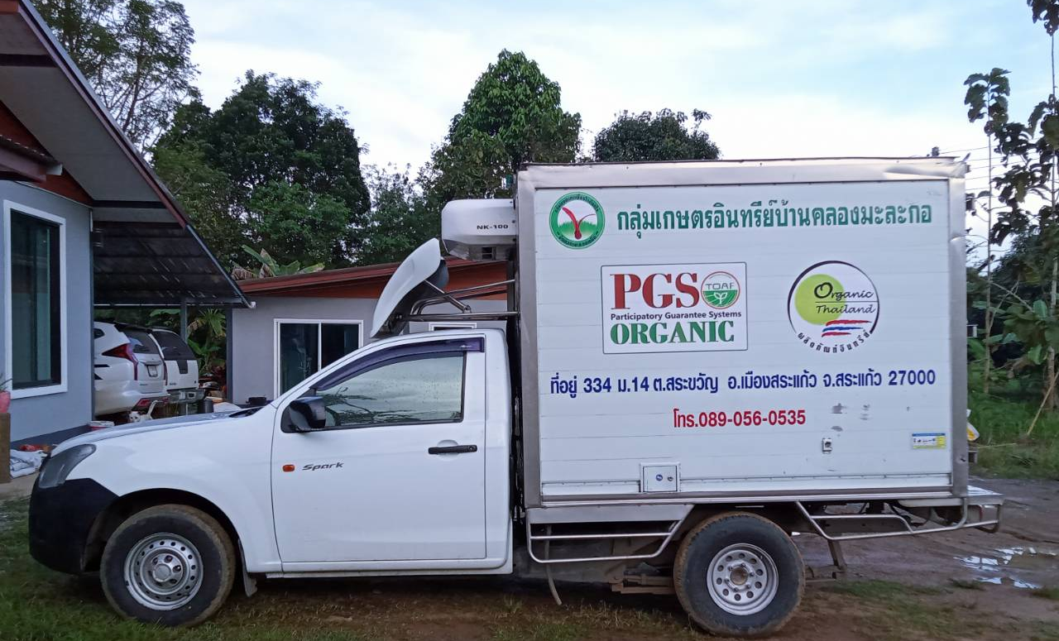
GMP, Good Manufacturing Practice Empowering community by
Government agencies to access more market
Processing and handling
Packing house
Fresh delivery car

Slide 21
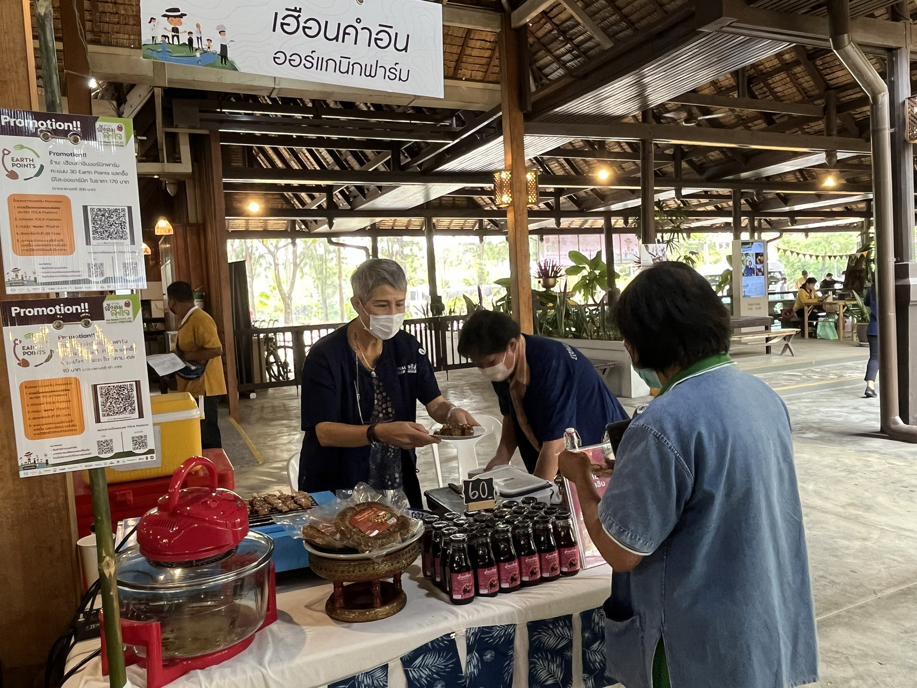
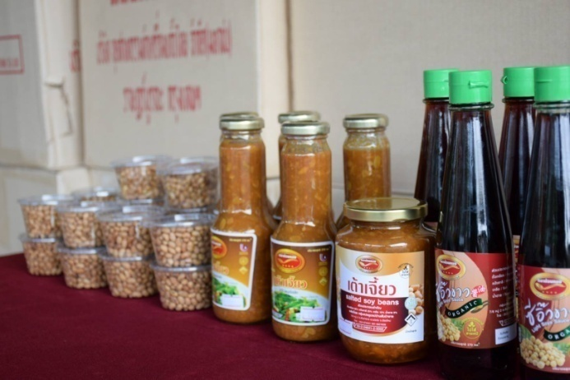
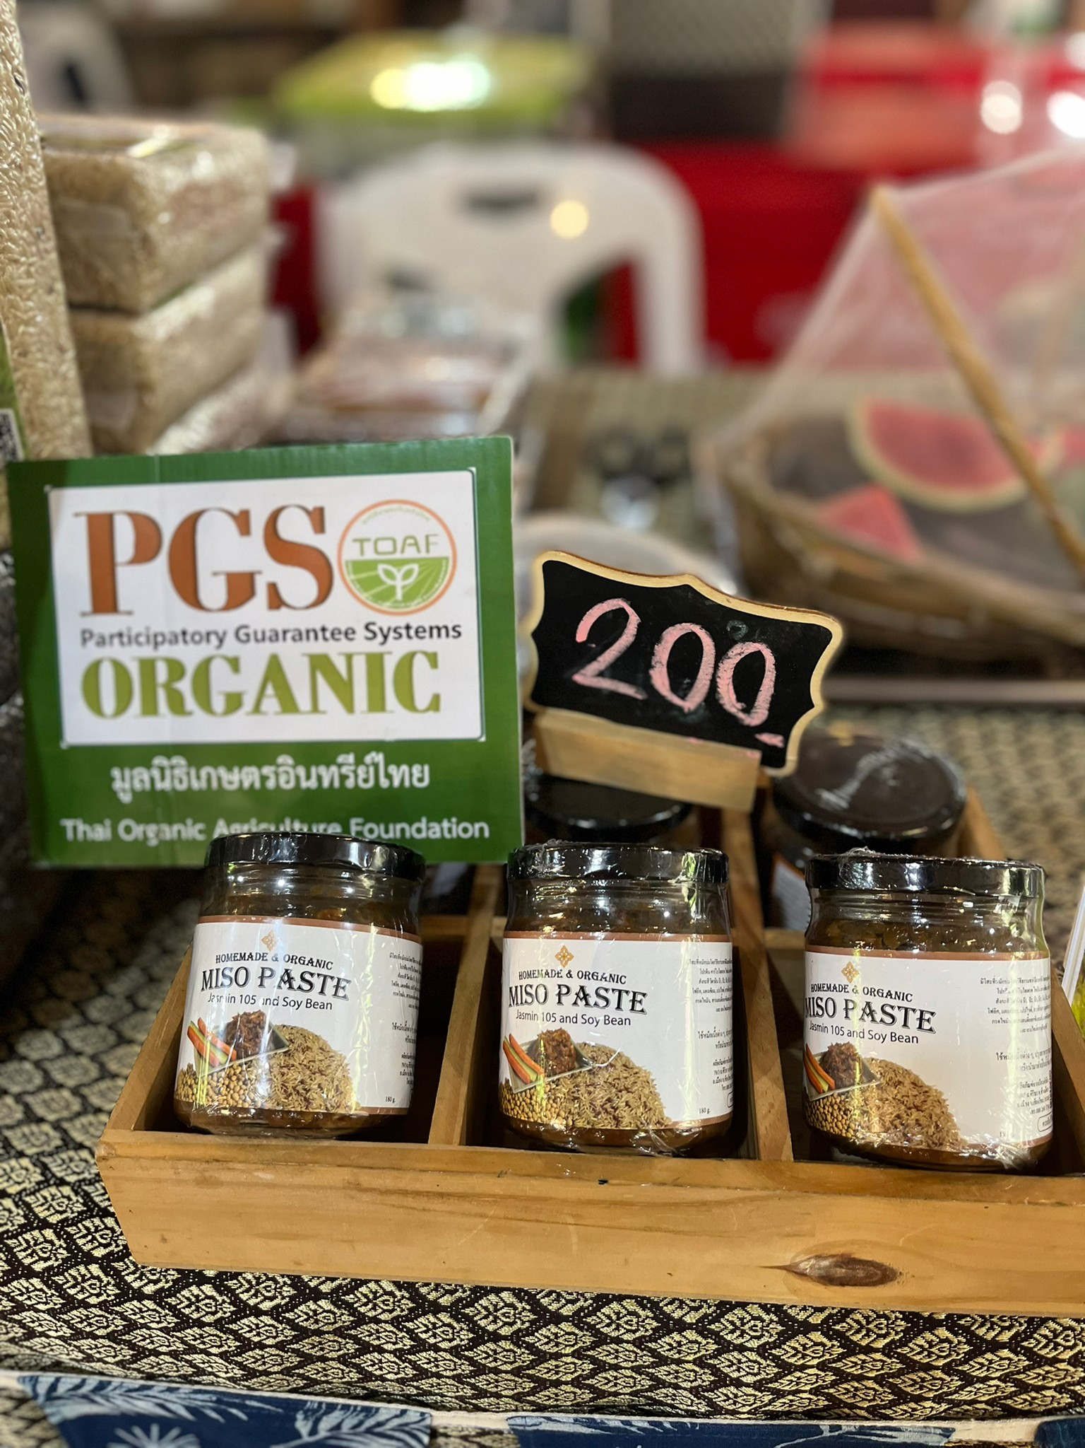
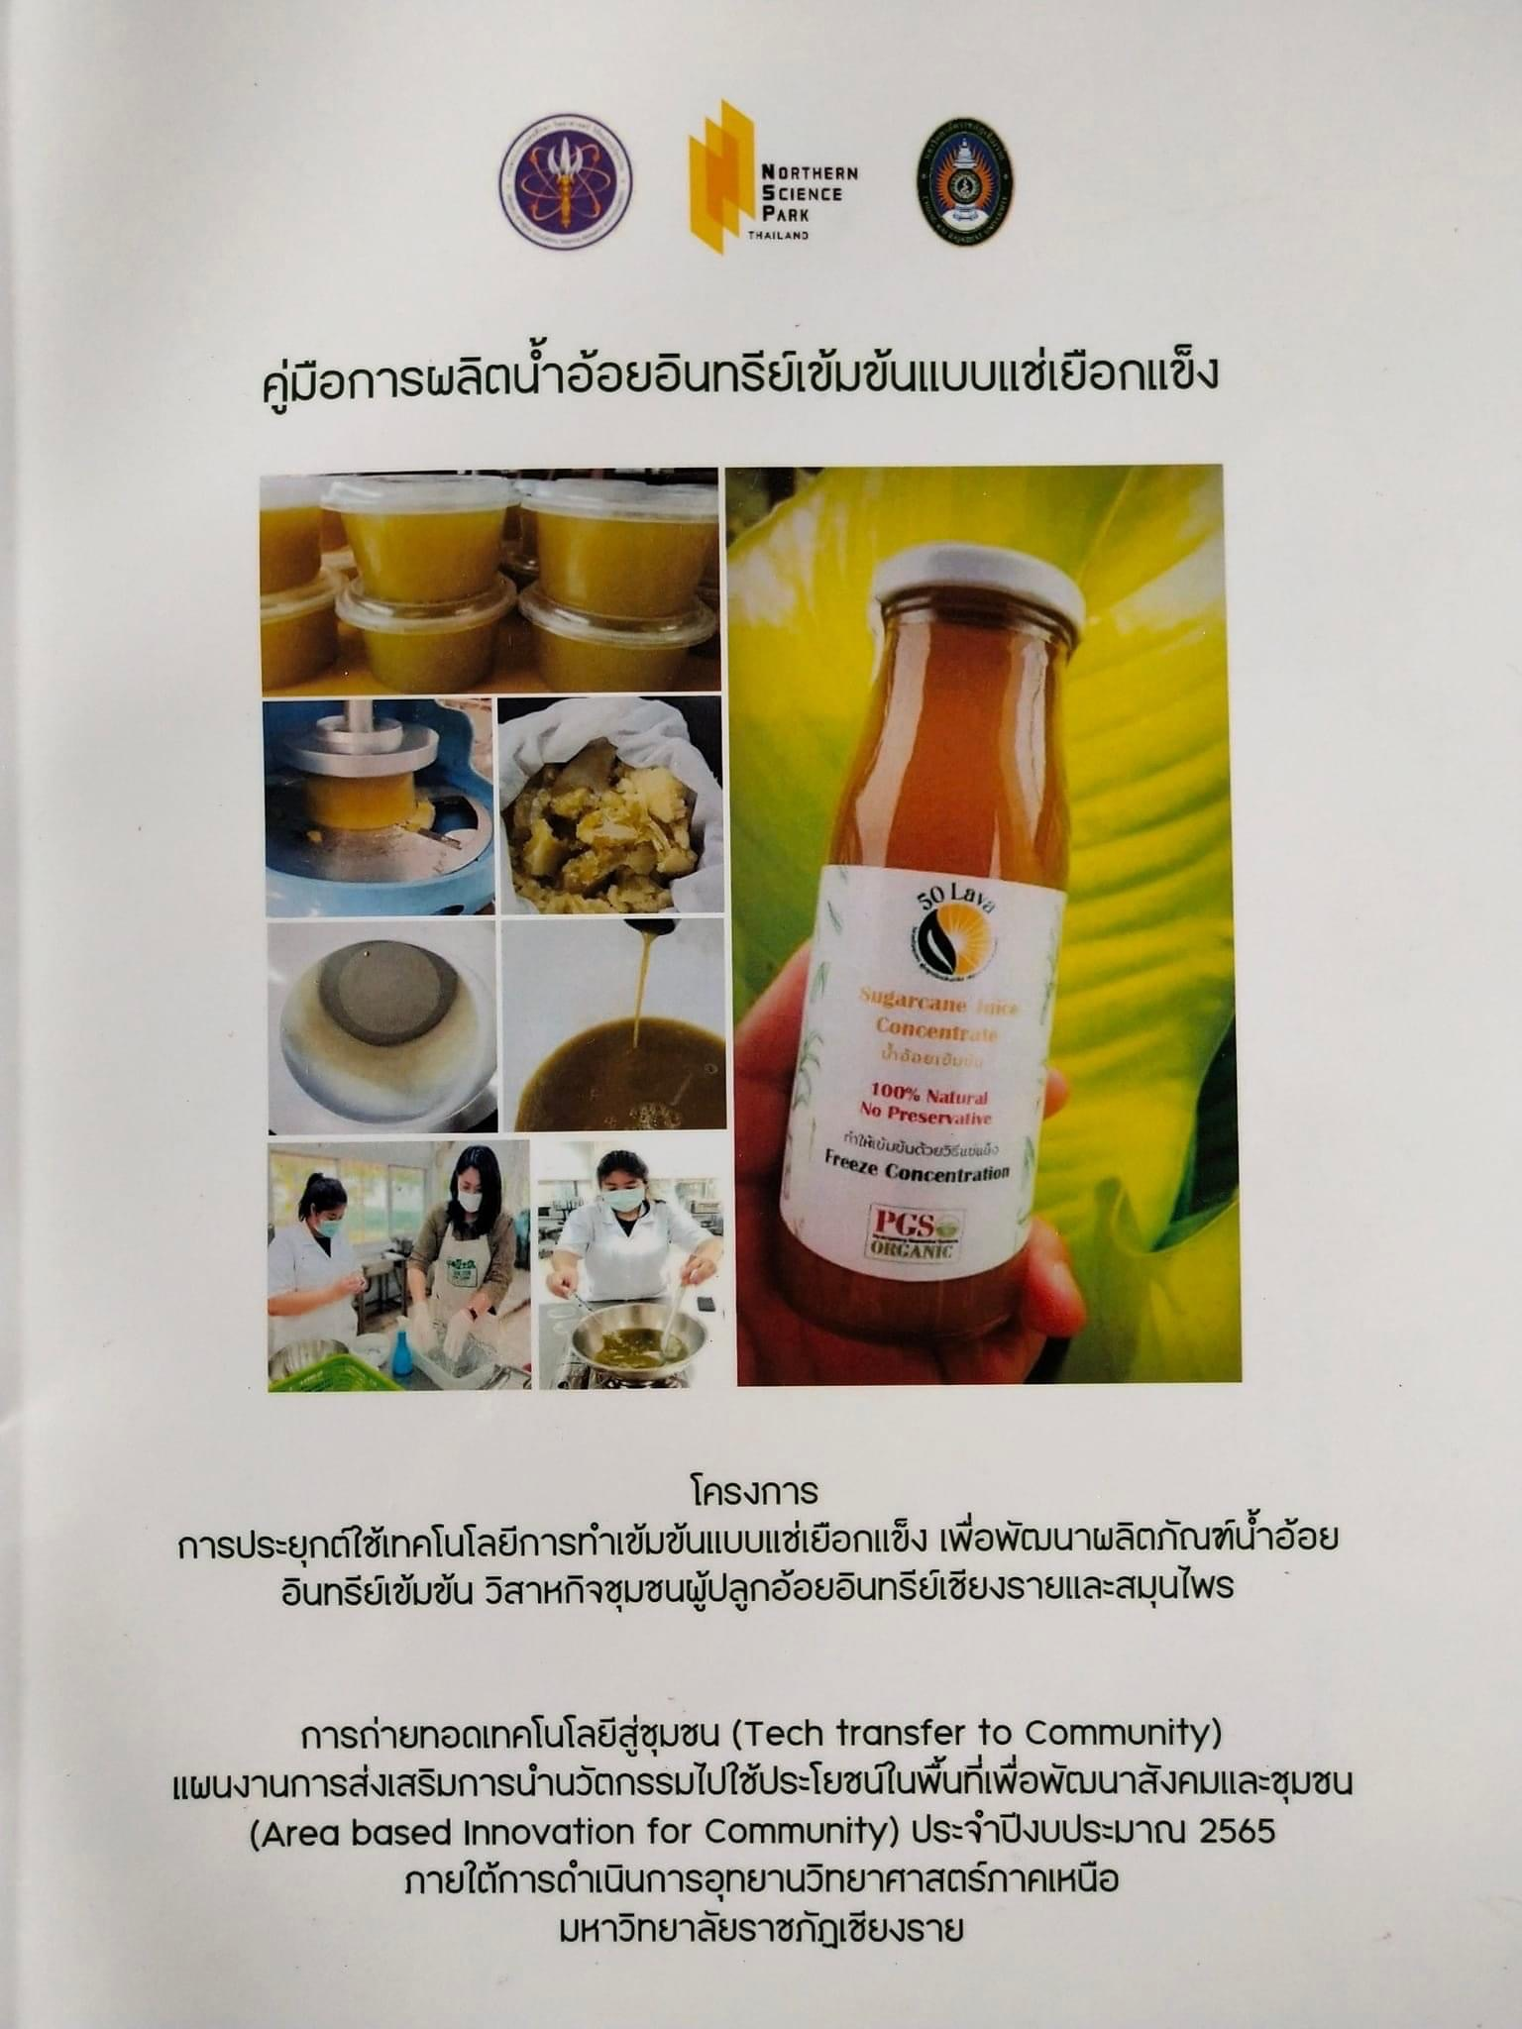
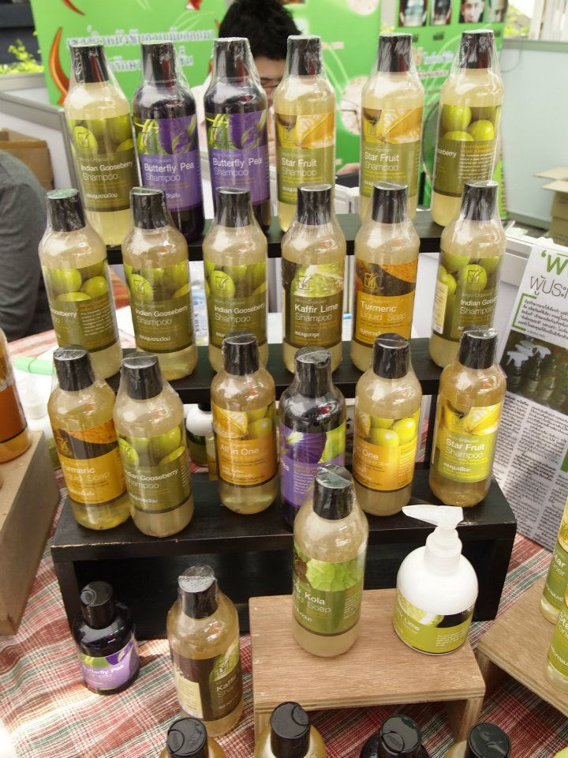
Processing & Handling
Soybean produces
Small-medium size
Homemade
Direct sale
Raw material from PGS networks and their own
GMP Government regulation control for food safety at processing plant
Shampoo

Slide 22
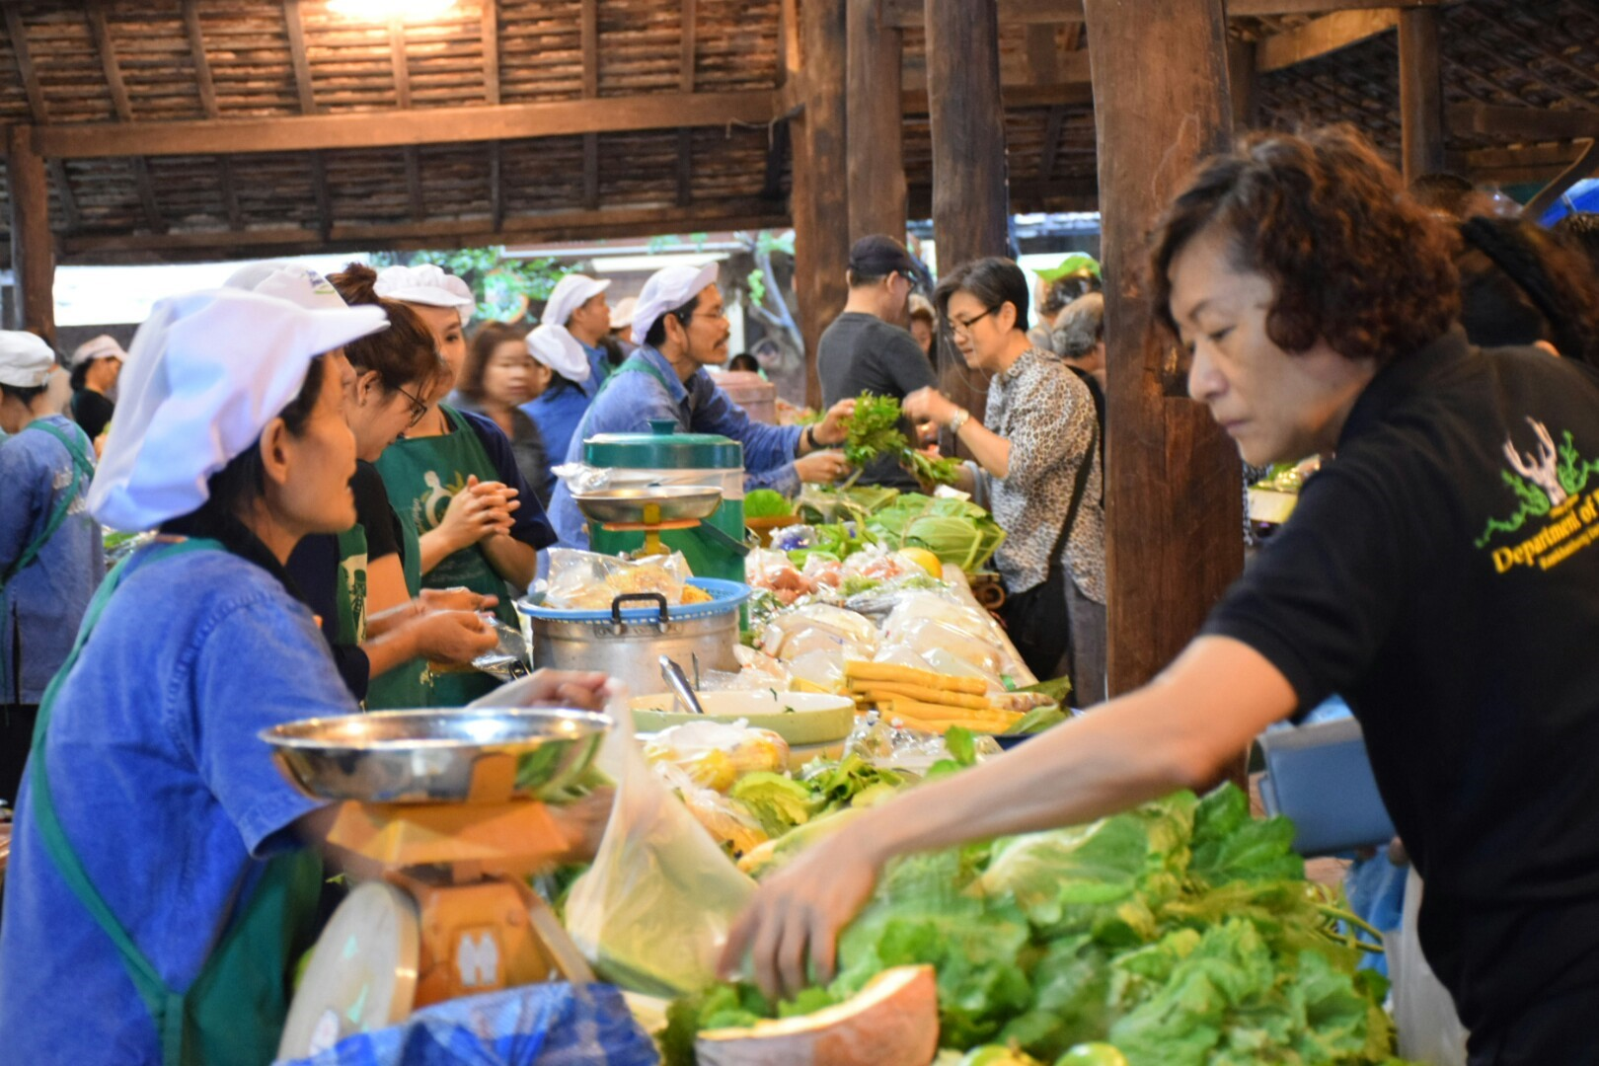
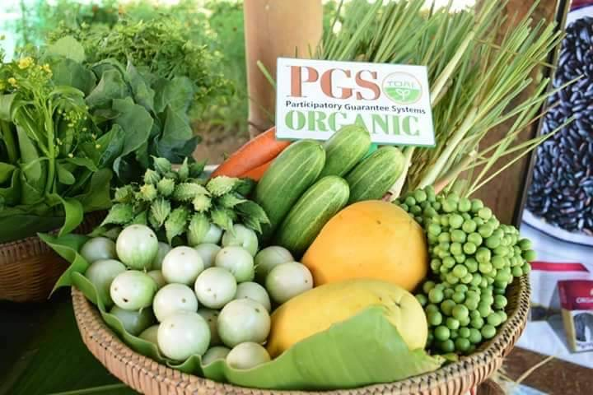
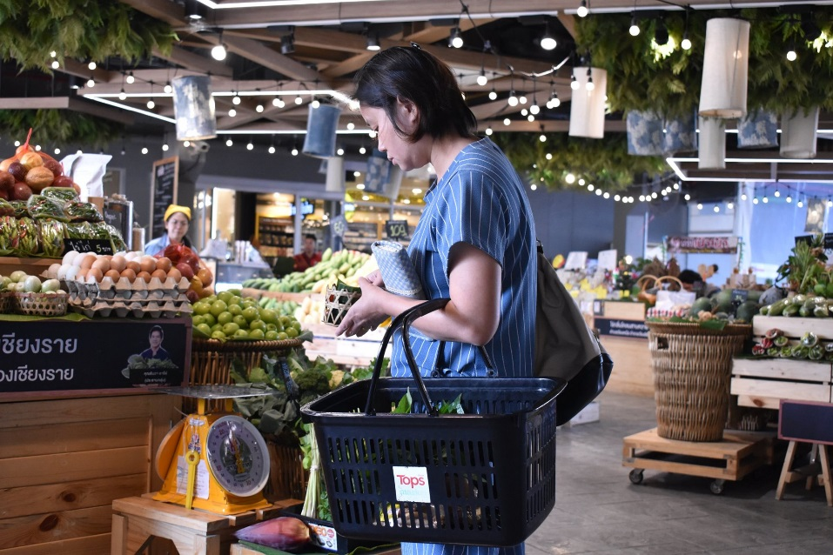

Promote local consumption at farmer market

Slide 23



Public procurement
Organic food for children/ patients
PGS co-creation platform to link Producers & Consumers

Slide 24





Local Food Economy Circular and Solidarity
Local consumption
Diversity of food
Healthy food
Small production and consumption
Use local resources to each other
Reduce energy in transportation
Self-sufficiency in food
Food security
Revolving income in the community
Farmer direct to consumer
Notes:
Shifting economic activity into the hands of small and medium size businesses instead of concentrating it in fewer mega corporation
Shortening the distance between producers and consumers where ever possible.

Slide 25
Lessons learned
Ideal of success groups
PGS isn’t just a certified system but it is a capacity building of the communities.
PGS is a tool for collective action bringing all stakeholders along food chain come together to develop healthy sustainable alternatives food system.
PGS group isn’t one size fit all it depend on their socio-economic, resources, tradition contexts of the groups.
PGS group
Community
Definitely connect to
the market
be as business farmers
> Direct sale
to consumers
Consumer relations
Self reliance
Coordinating with most agencies

Slide 26


Thank You

