Slide 1
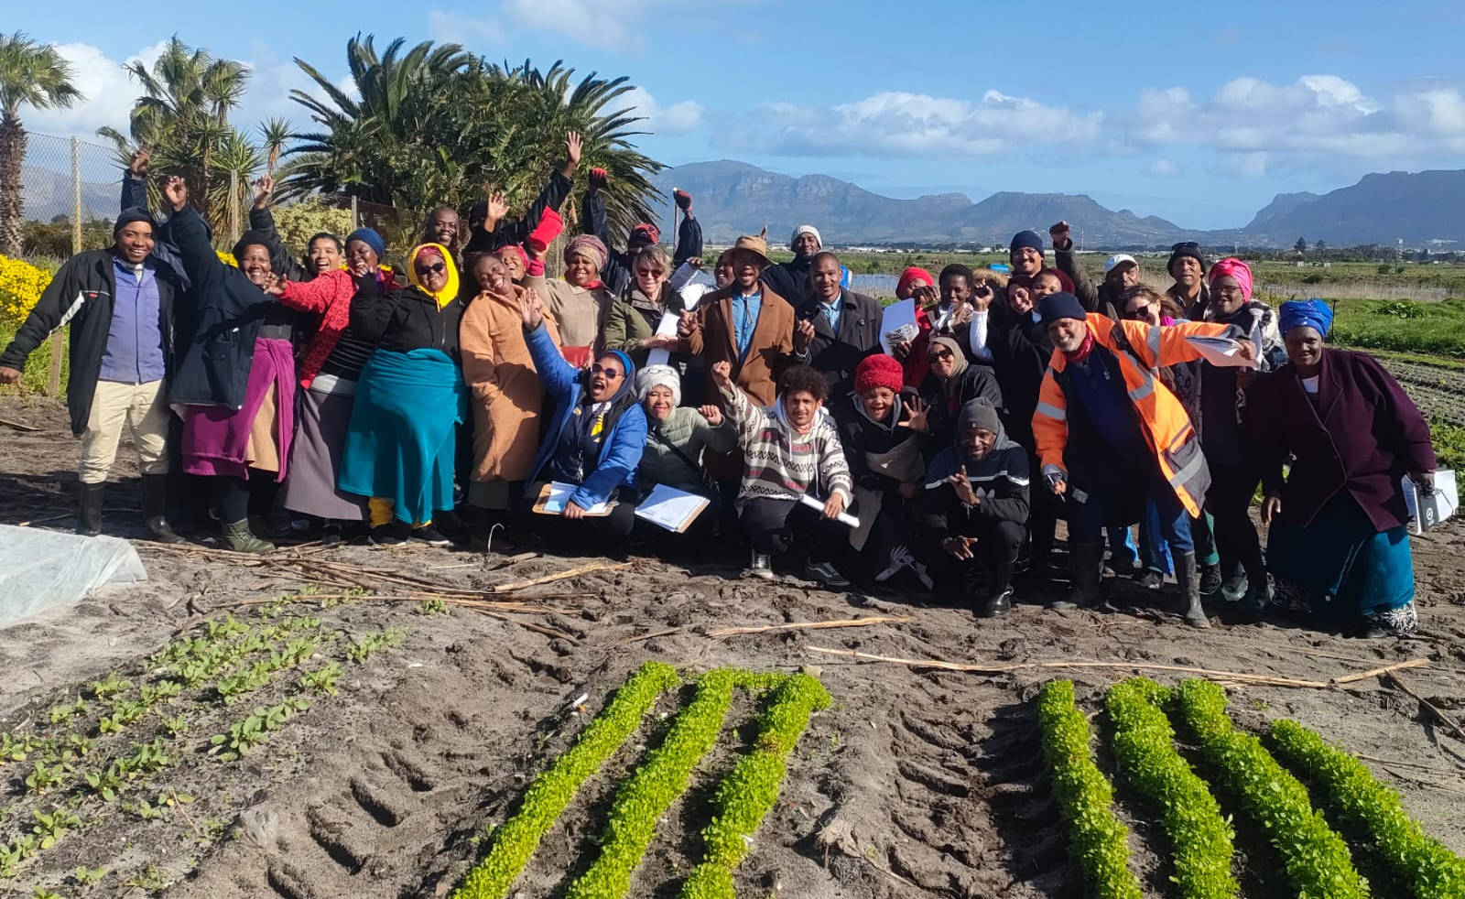

Digitization of Agricultural Value Chains - South Africa.
Innovation towards food system evolution – Providing the digital solutions for Organic 3.0.

Slide 2
Challenges in agriculture / economic development

Slide 3
Agriculture Sector Challenges
Challenges include:
Developing a holistic approach for the South African agricultural industry.
Silos in the value chains create significant inefficiencies.
No national framework exists for the Identification and Traceability of Agricultural product.
Technology platforms, innovations and solutions are not integrated to support the broad industry objectives.
Comprehensively managing risks across the agricultural industry and across the value chains.
Intelligently directing funding according to a strategic plan.
Utilising data to measure and manage operations, output and impacts.

Slide 4
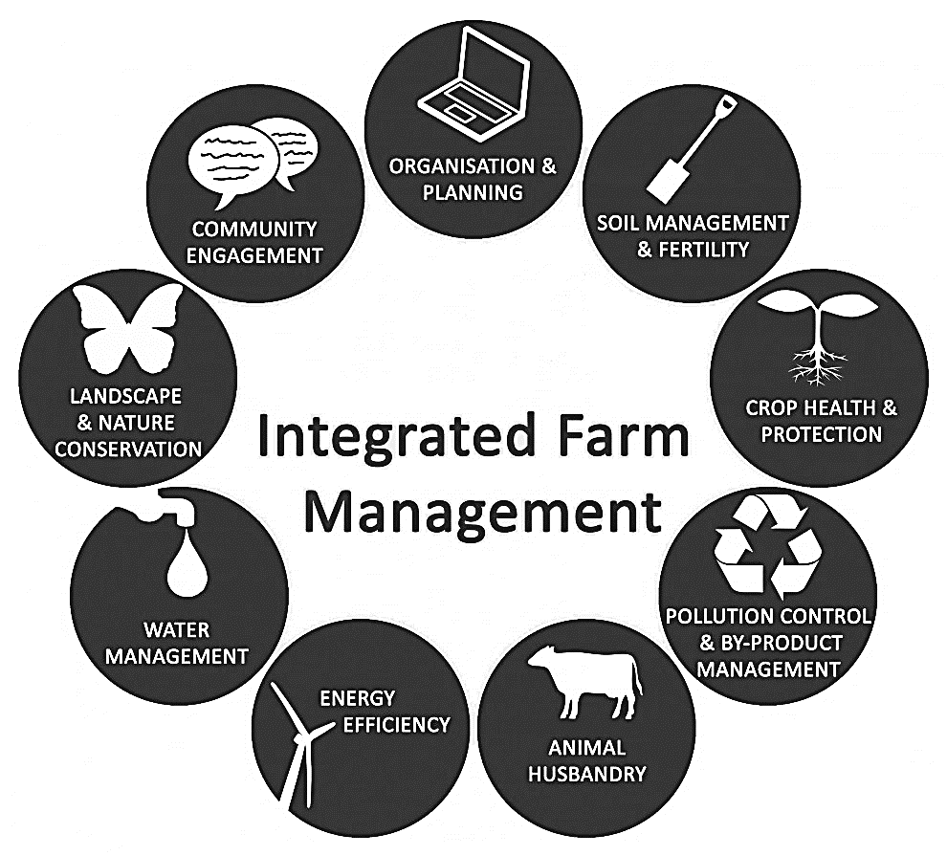
The Sustainable Agriculture Value Chain (SAVC)
The Sustainable Agriculture Value Chain (SAVC) initiative
- addressing the sector value chain challenges holistically and sustainably.
Harnessing sustainable agricultural practices and economic activities.
Implementing a rich, integrated suite of protocols.
Catalysed by development and impact funding.
Operated with insightful 4IR technologies, platforms and practices.
Enabling ESD solutions and impact measurement
Integrated
Agricultural
Management

Slide 5

NPC –
SAOSO Foundation
Core Vision
Promoting sustainable development and climate change adaption through a clean and ethical food system that preserves the health of soil for the 7th Generation.
Strategy
Climate Change Adaption through Land Care
Green Economy
Establishment of Grassroots Movements
Food System Transformation
Circular Economy
Environmental, Social Governance
Sustainable Development Goals
Board of Directors
Operations – Core team (Paid Staff)
Training, Research & Extension
Advocacy & Communication
Value Chain & Market Development
Network & Partnerships
Program Development & Innovation
Standards & Certification
Preservation of indigenous knowledge systems.
Action drive research for organic agriculture and food system.
Development of training programs
Skills development youth and woman.
Extension service will transfer skills to farmers and communities.
Establish alternative to FISP.
Developing targeted campaigns
Policy reform for Agroecology and Organic Agriculture.
Civil society participation in shaping the future of the food system.
Brand development for organic
National information and communication strategies.
Consumer awareness loyalty program.
Revival of Government engagement (OSSIC)
Stimulate the development of sustainable markets in increased trade.
Development of local food systems for domestic.
Trade Desk for market access regional and international
Stimulating the manufacturing of organic inputs and seed.
Encouraging value addition through Agro-processing
Job creation and employment opportunities for woman & youth.
Development of sector partnerships.
Promoting engagement including government, farmers & private sector
Maximize impact
Expand geographical reach through out SA and the region.
Government Engagement
Joint fundraising targeting grassroots activities
Donor & Partnership Management
Cooperative Governance and civil society participation
Establishing Centers of Excellence nationally.
Endorsement of national programs linked to NGO’s.
Prototyping Organic 3.0 at Centers of Excellence.
Technology and Innovation.
Engagement with national and local Government for alignment to national programs.
Monitoring & Evaluation
Custodian of the SAOSO Standard.
Maintaining the integrity of the SAOSO standard for processing and production.
Labeling and traceability.
Governance of the standards and certification. Establishment of PGS groups nationally 2nd party certification.
Working with 3rd party certification for export.
Working with retailers for the acceptance of organic produce.

Slide 6


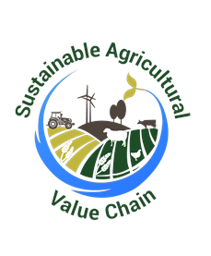


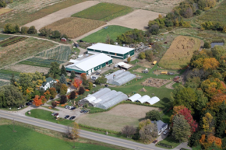
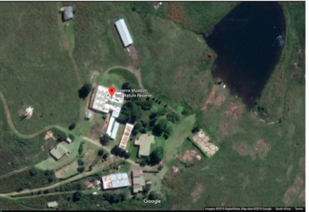

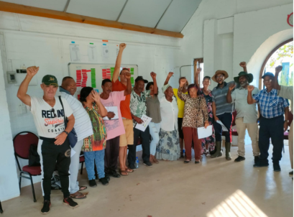




SAOSO Foundation
Centres of Excellence
AgriHubs
AgriHub #2
Byrne Valley AgriHub
PGS Nodes
Swartland PGS
KZN PGS communities

Slide 7
ICT Challenges
ICT Challenges
FARMER
The size and complexity of the agriculture value chains.
Managing the number of role players and stakeholders.
Tracking, monitoring and managing complex ecosystems.
General lack of quality control which does not allow for effective interventions where required.
Dated, incomplete on inaccurate information across the entire value chain,
Limiting stakeholders ability to accurately predict, plan or intervene when required.
Producers are not able to receive the support they need, when and where they need it.
General inefficiencies
FINANCIERS
INSURANCE
FEEDER FARMS
MARKETS
GOVERNMENT
RETAIL
PROCESSING
SUPPLIERS
TRANSPORT
ORGANISATIONS
CONSUMER

Slide 8
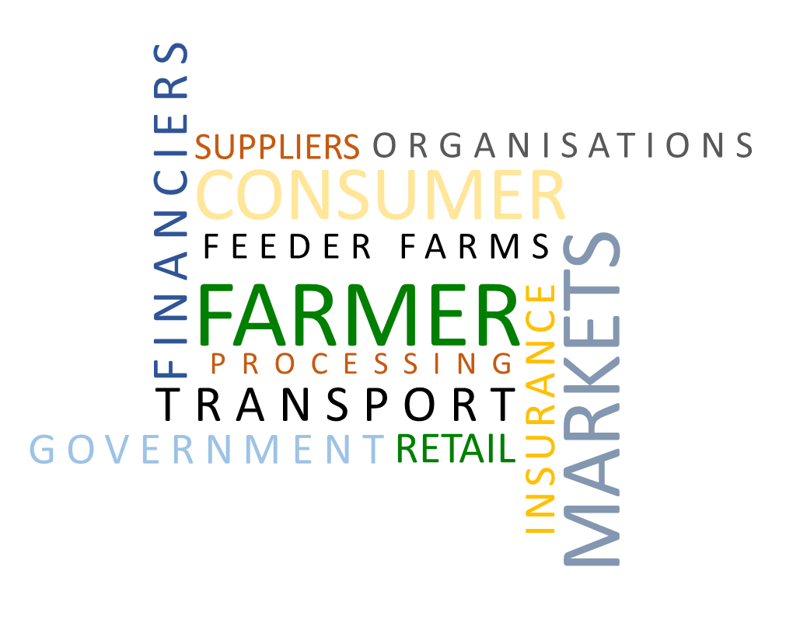
ICT Solutions
Solutions include:
Identification and Tracing platform and services where a centralised database facilitates the intelligent processing of large volumes of data.
In the livestock sector this is referred to as the Livestock Identification, Tracking and Tracing (LITT) platform.
LITT reduces the complexity to offer useable data for industry players and stakeholders to identify, track and trace livestock products throughout the supply chain.
The Sustainable Agriculture Value Chain (SAVC), facilitates programme planning, contracting, risk mitigation and support.
Enabling AgTech, i.e. the digitization of agriculture to support the radical shift that is needed to retool our food system and make the most of what we have for a growing population.
AGTECH

Slide 9
SAVC ~ enabling agriculture value chain programmes

Slide 10
SAVC ~ multiple value chains

Slide 11
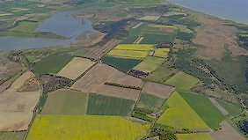

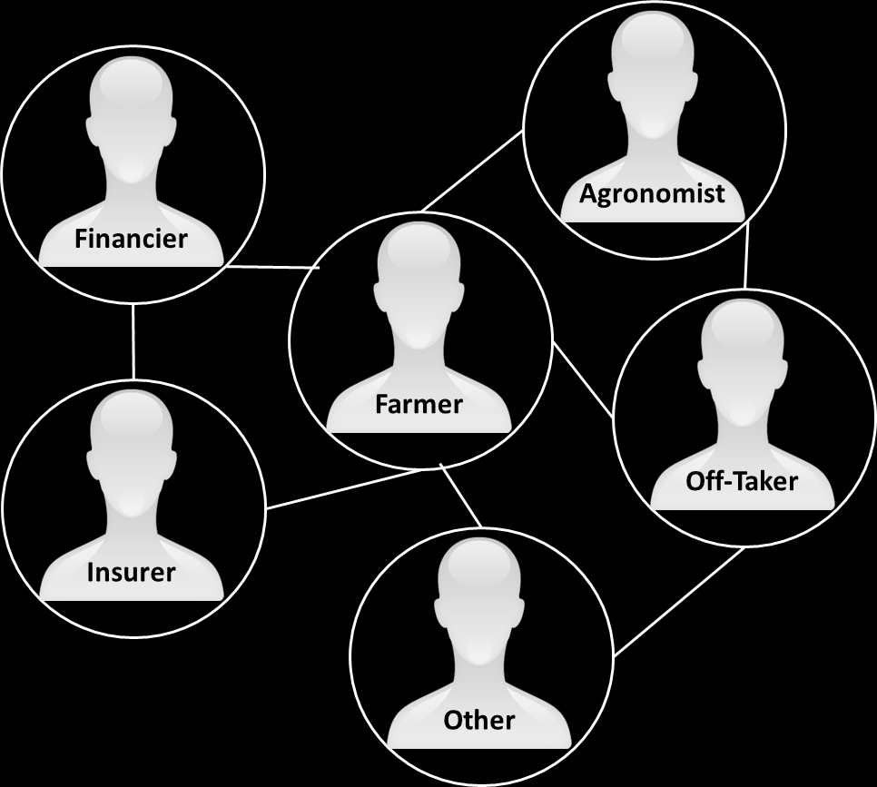
Financial Auditing
Production
InsurTech
Products &
Services
Off-take Agreements
Food Security
Disease
Control
Supply Management
Sustainability
STAKEHOLDERS
Quality
Control
Livestock / Crop Protection
Tracing
Food With Integrity
Demand Management
Tracking
Quality
Control
Risk Mitigation
Farm Planning
Compliance
Forecasting

Slide 12



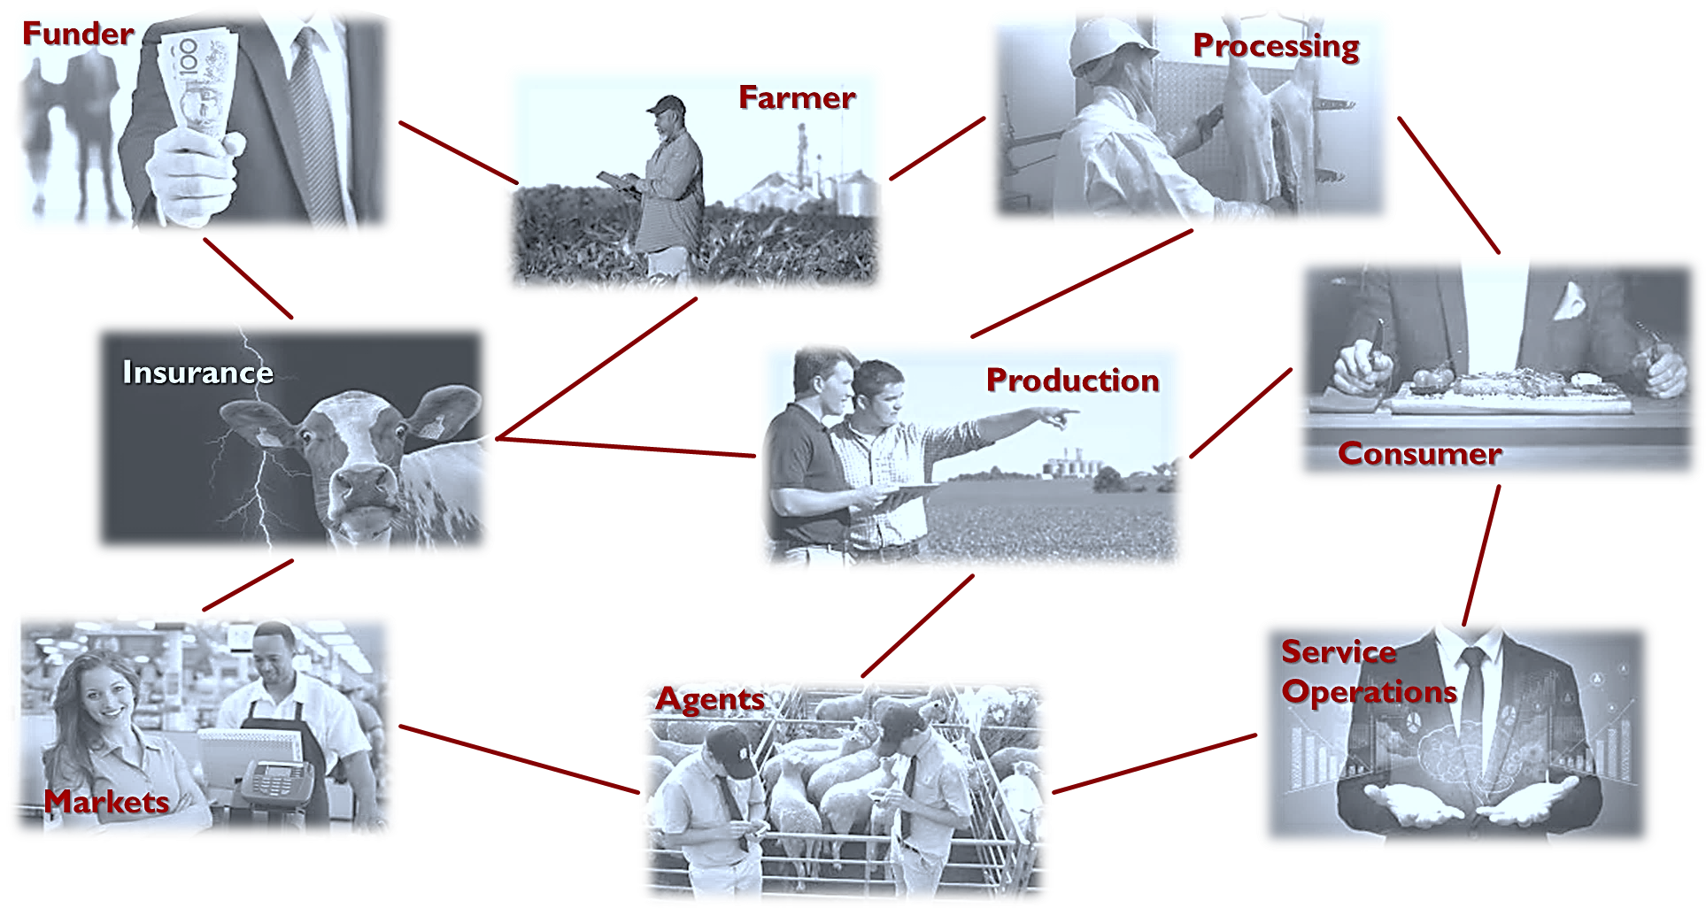


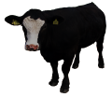







Stakeholder Information Expectations
Alerts
Monitoring
Tracking
Tracing
Performance
Analysis
Health
Planning
Husbandry
Nutrition

Slide 13
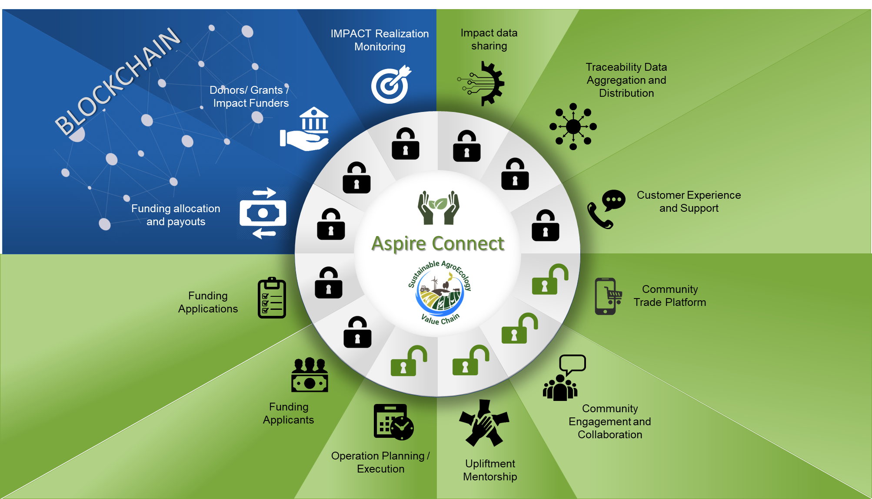

Slide 14
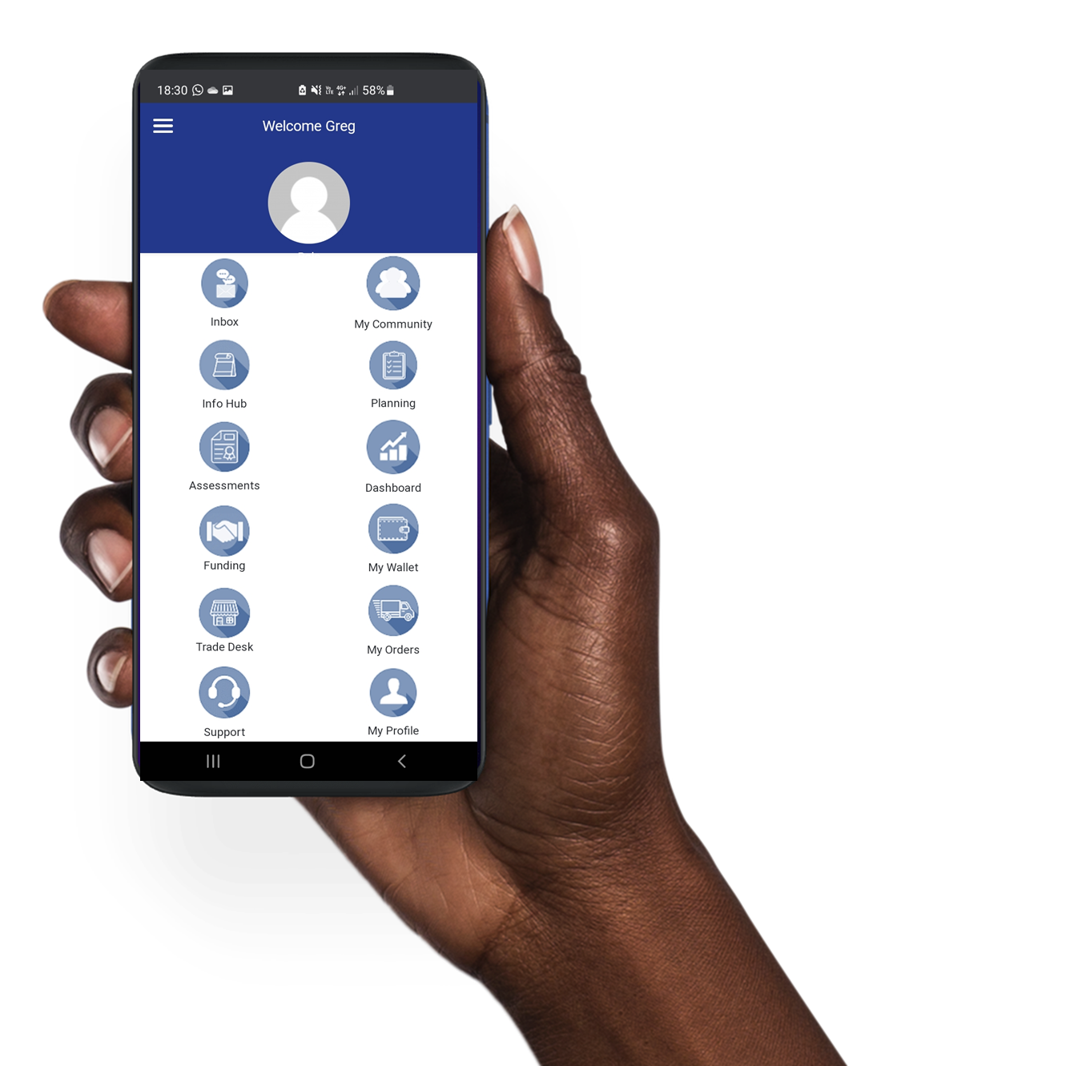
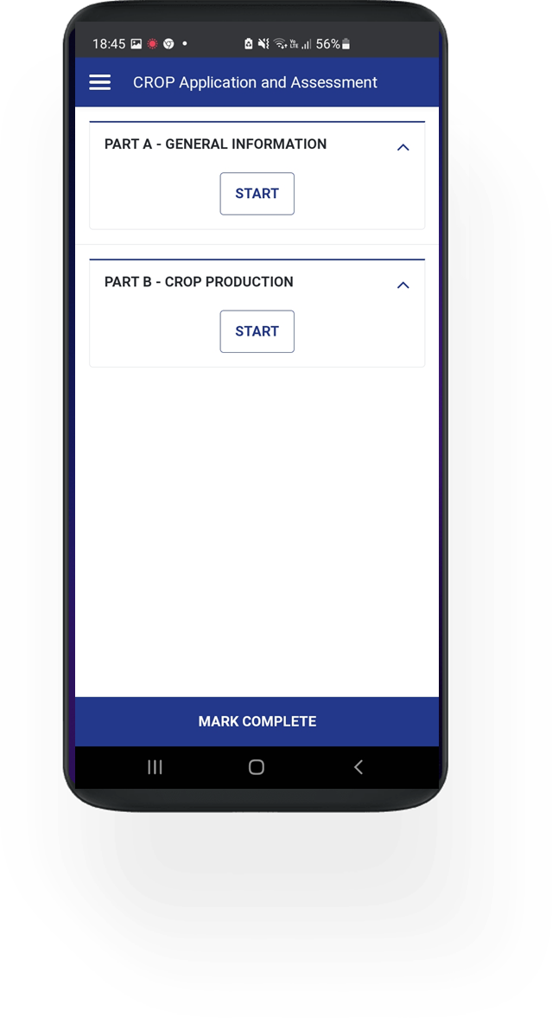
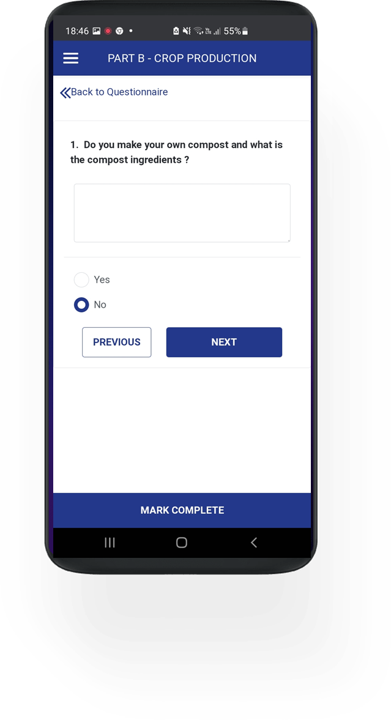
Example of App

Slide 15
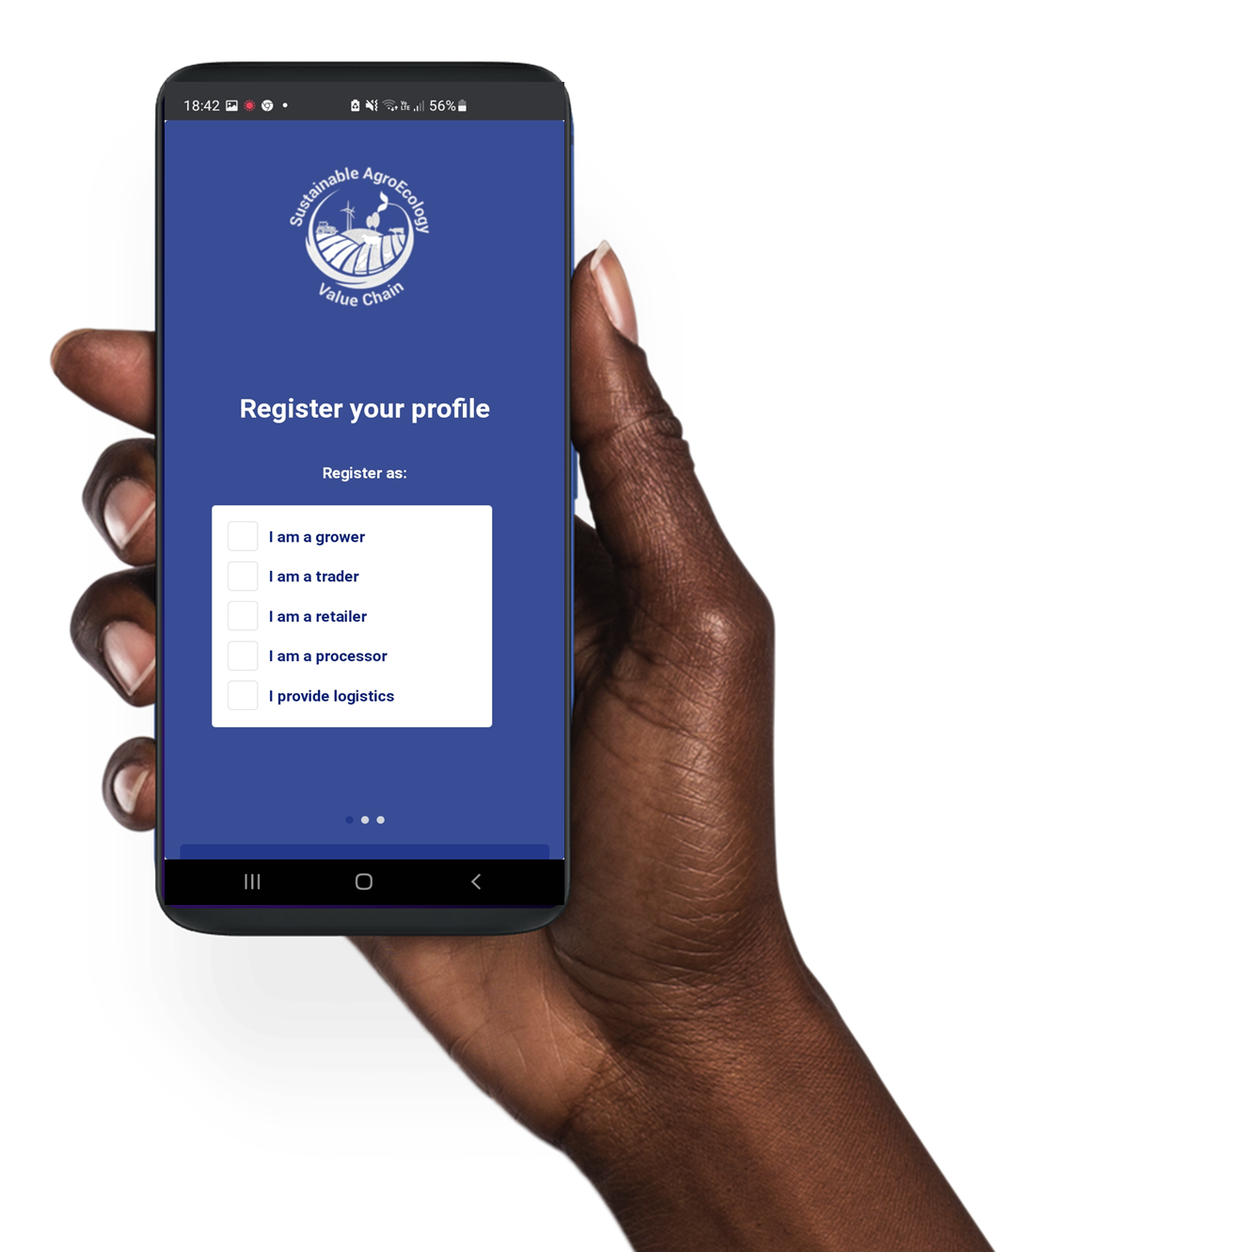
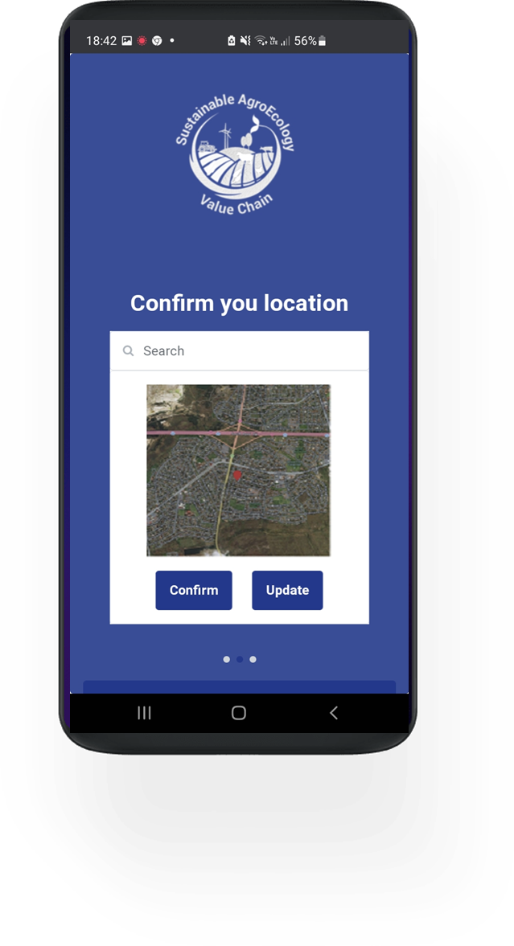
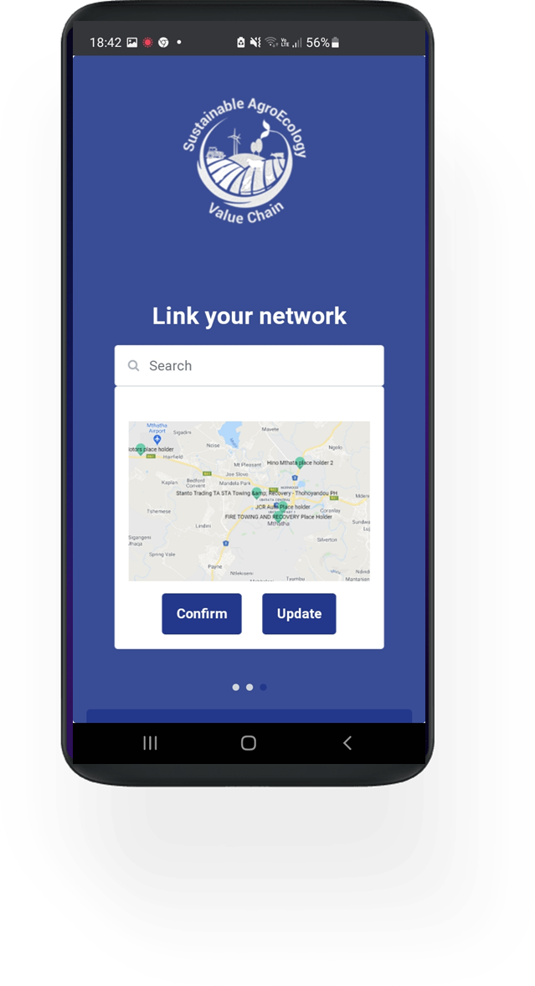
Example of App

Slide 16


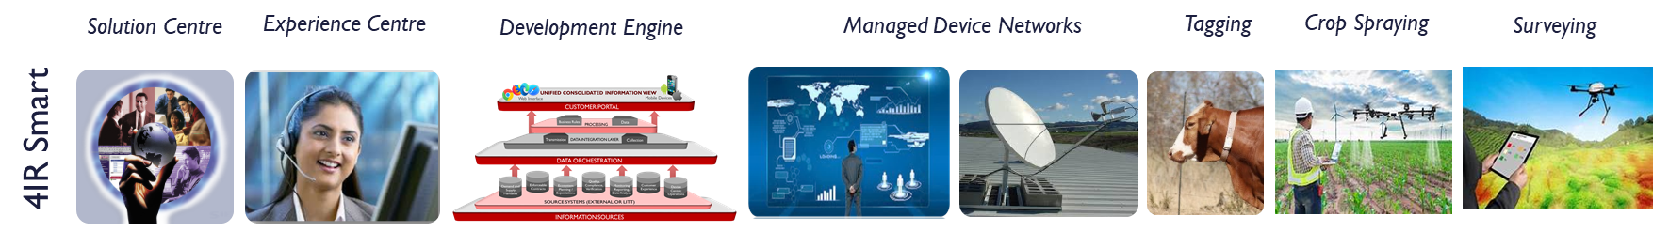
AgTech delivered
AGRICULTURE VALUE CHAINS
CROPS
LIVESTOCK

Slide 17
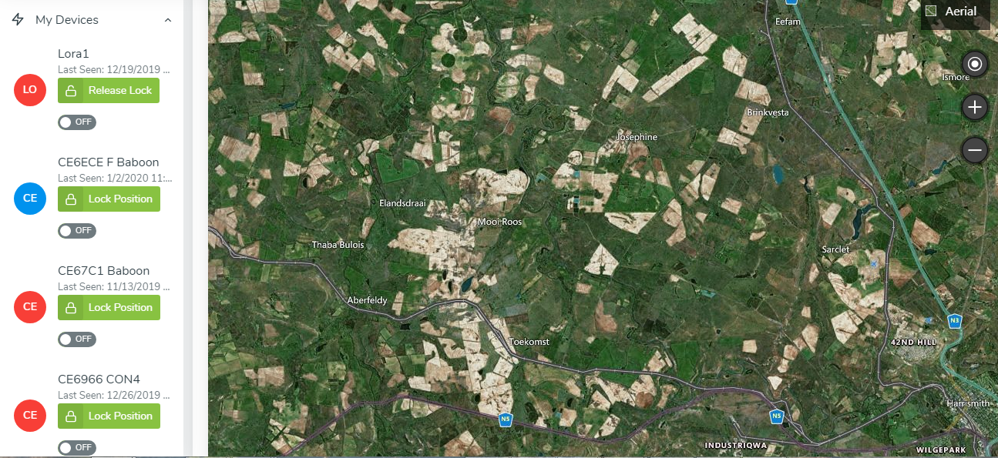
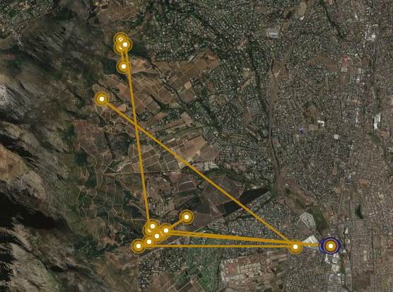
AgTech delivered
SMART ALERT AND INSIGHTS
SMART ALERT AND INSIGHTS
CROPS
CROPS
Situational Awareness
Insights and Analytics
LIVESTOCK
LIVESTOCK

Slide 18
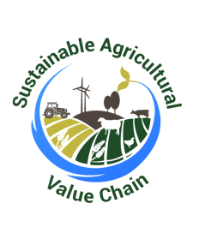


SAVC ~ Collaborating Entities
Funders
Investors
VC Programmes
Trade Facilitators
Implement Agent:
Crops / Livestock
Economic Development Framework
Academia:
Sector Programmes:
Regen / Organics
Agri Influencers:
Sector bodies, NPO’s, etc.
SAOSO Foundation
Care for the Planet
PGS SA
AvoVision
Tertiary Institutions
Care for the Planet
Village Up
Regen SA
IFOAM / Organics
SOASO
PGS SA
Social Enterprise
Circular Economy
Training / Mentorship
True Cost Accounting
Socio Economic Dev
Mentoring
Business support
Funding Management
Training
CSA
Model AgriHub
Rural Development
AgriHub / Model Farm
Protocol / Practice
Youth Program / Leadership Academy
Production
GAP / standard
Regulation & Compliance
Ecological Organic Agriculture practice

Slide 19
SAVC | Care for The Planet

Slide 20
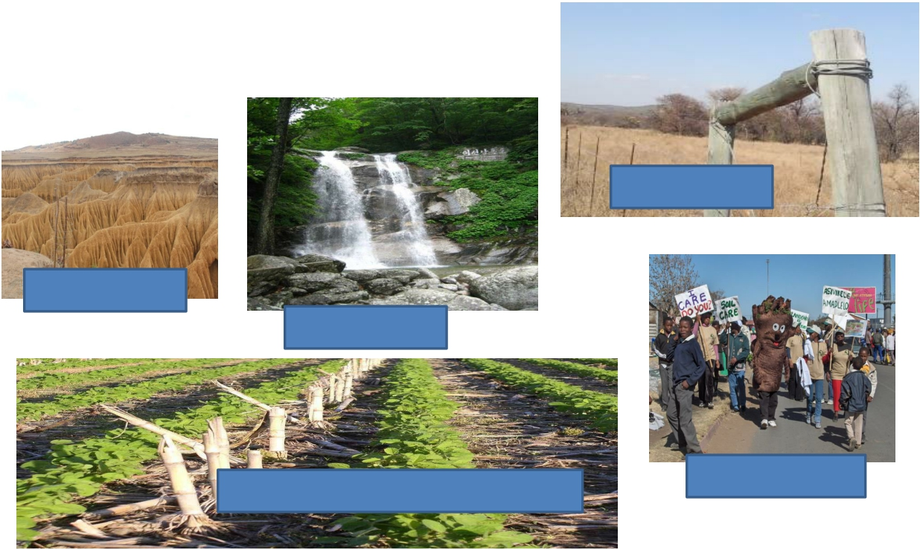


SA LANDCARE FOCUS AREAS
VELDCARE
SOILCARE
WATERCARE
ECOLOGICAL AGRICULTURE
JUNIORCARE

Slide 21
Metrics ~ True Cost of Accounting
True Cost Accounting
the unique measuring metric
Measuring the impact
Nutritious food
Ecological approach to farming
Quantifying the impact
Donor reporting
Actioning the impact
Innovating new methods
Guiding the M&E process
Facilitating intelligent funding

Slide 22
Addressing ~ SDG / ESG criteria

Slide 23
Addressing ~ SDG / ESG criteria

Slide 24
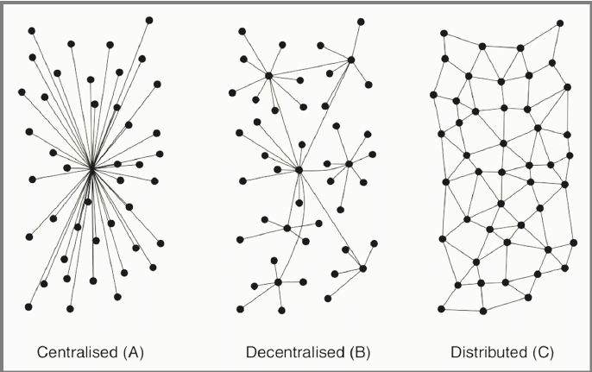
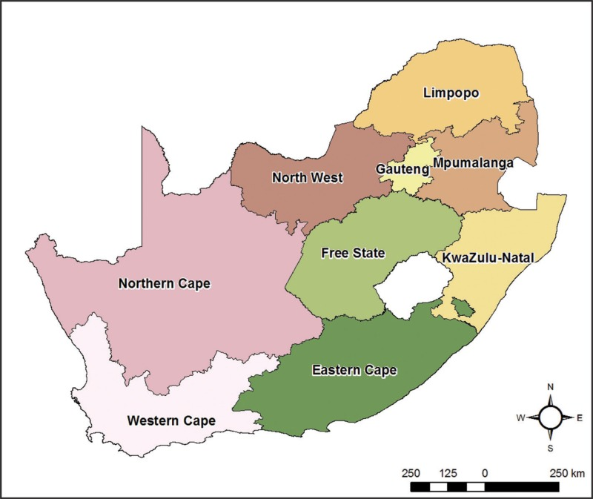
Food System Evolution 2021-2030

Slide 25
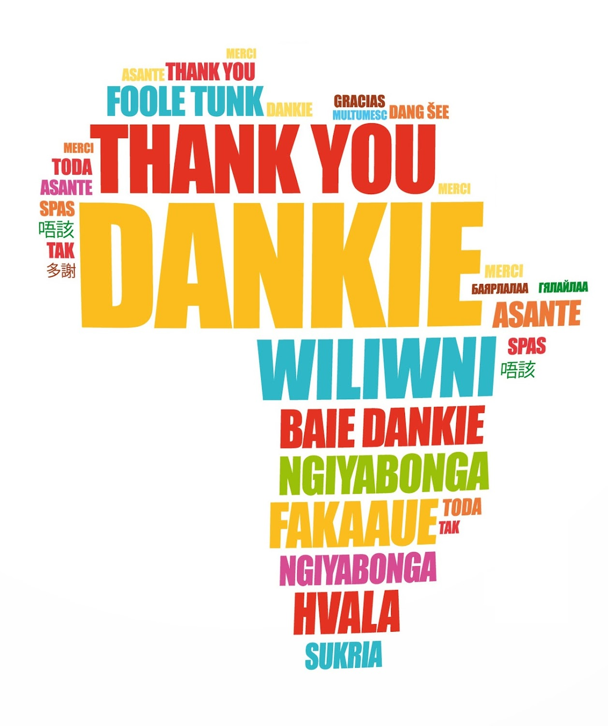
Website:
www.saoso.org
www.pgssa.org

