Slide 1
Participatory Guarantee Systems
How do we ensure existential, economic and functional sustainability?

Slide 2
Does this sound familiar?
It is hard to justify the development of PGS, as it hardly will be cheaper than 3rd -party group certification.
Ownership and accountability of the system needs to be clear and consistent with the idea of PGS (i.e., local ownership, ownership by the farmers’ group).
Existing cultural or social features that are valuable in a PGS system should be integrated into the system.
Costs for operating the system should be made visible, and financing needs to be sustainable (i.e., the costs should be recovered from the business).
Transparency should be a cornerstone for the PGS.

Slide 3
Does this sound familiar?
Lack of supply: major obstacle to local market development.
Limited premium prices in local market.
Need for local organic quality assurance.
Need for consistent labeling and promotion of organic.
Local certification service is too costly.
Standards & certification procedures too demanding
Certified farmers can’t use existing certification for local market.
Many groups of farmers are too weak to deal with certification.

Slide 4
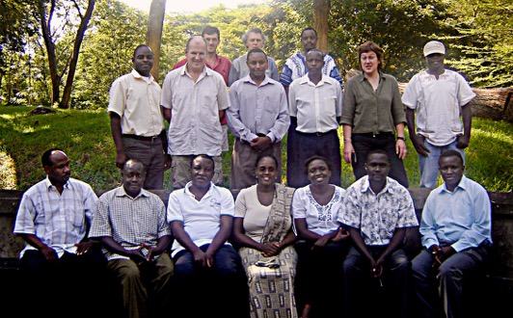

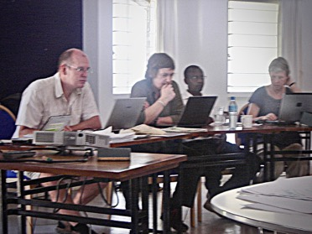

PGS in East Africa
Commissioned by | IFOAM IFOAM Head Office Charles-de-Gaulle-Str. 5 53113 Bonn, Germany Phone: +49 - 228 - 92650 - 10 Fax: +49 - 228 - 92650 - 99 Email: HeadOffice@ifoam.org www.ifoam.org Gunnar Rundgren (Grolink AB) Assisted by NOGAMU, KOAN and TOAM June, 2007
Consultant
First OSEA-PGS Workshop in Arusha, 3 April 2007

Slide 5
Reality check…
First functioning PGS in Africa recorded in 2005 in South Africa – considered “not appropriate” for Africa as farmers and consumers were considered “too well-resourced”!
PGS introduced to NOAMs in Southern and East Africa 2005 - to West Africa in 2007.
Project support for PGS development started in 2005 and continues to grow. (Multimillion Euro investment in direct and indirect funding)
Looks very good in project proposals and reports - how good do they look after the project ends?
Notes:
16 Years later?

Slide 6
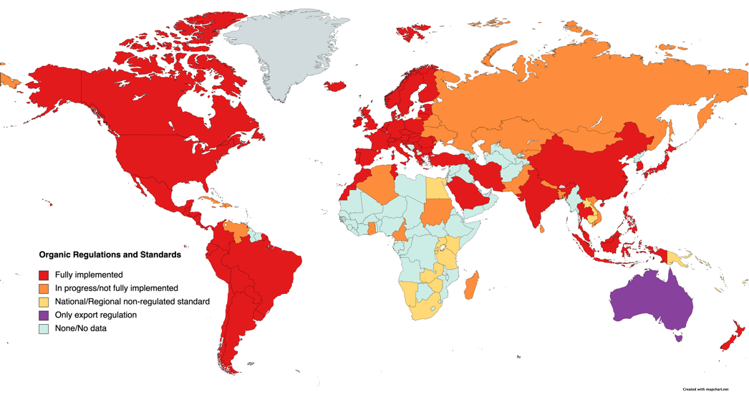
A regulated organic world
Source: Agence Bio, FIBL/IFOAM and Australian Organic Ltd

Slide 7
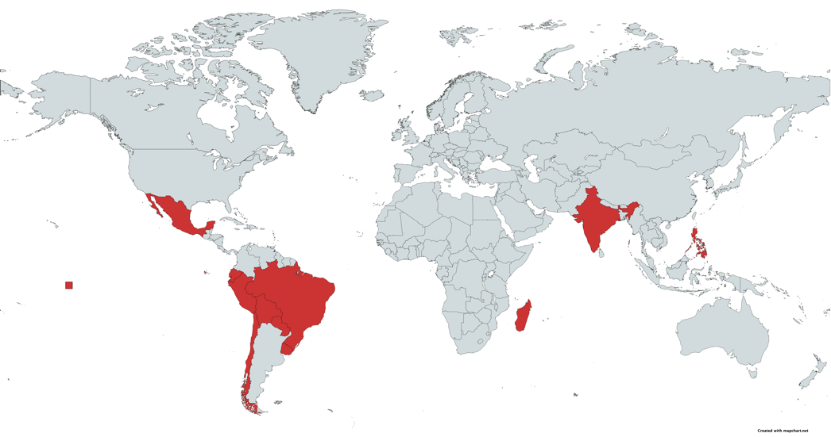
PGS in national legislation/regulation

Slide 8
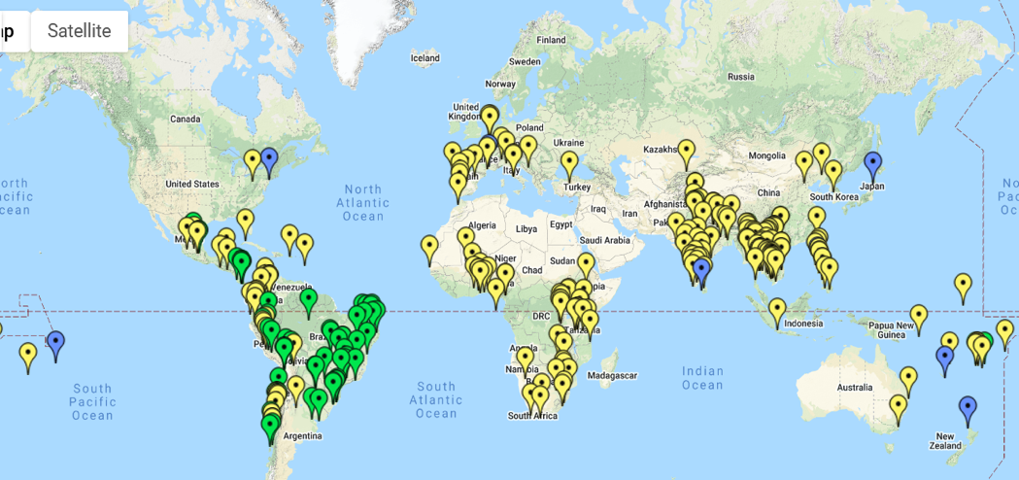
PGS active worldwide
?
https://pgs.ifoam.bio/

Slide 9
PGS develops well where:
Local market demand exists or has a high potential.
Local suppliers are active with the capacity to produce (surplus) organically.
Consumers require an organic guarantee.
Farmers require a way to furnish it.
An existing culture of collaboration and trust.
A local and short value/supply chain.
PGS is a social process and a labour of love.
Without a love for the soil and love for your neighbour, it will not flourish.
9
Notes:
9

Slide 10
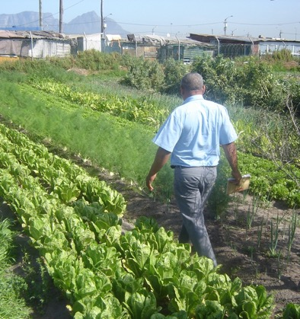
When should we encourage farmers to go to market?
When they:
have secure access to land,
want to farm,
are committed to organic principles,
are organised, and…
are capable of producing surplus!
“Survival > Subsistence > Sufficiency > Surplus”

