Slide 1
Participatory Guarantee Systems
The fundamental principles of PGS

Slide 2
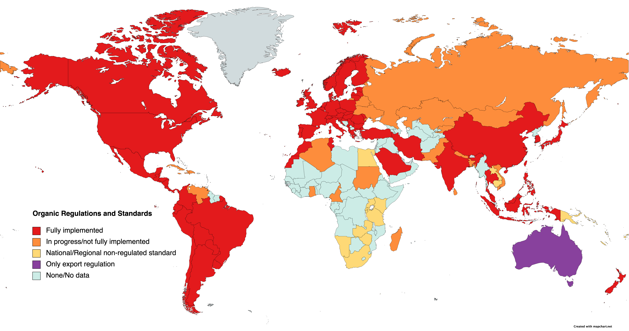
A regulated organic world
Source: Agence Bio, FIBL/IFOAM and Australian Organic Ltd

Slide 3
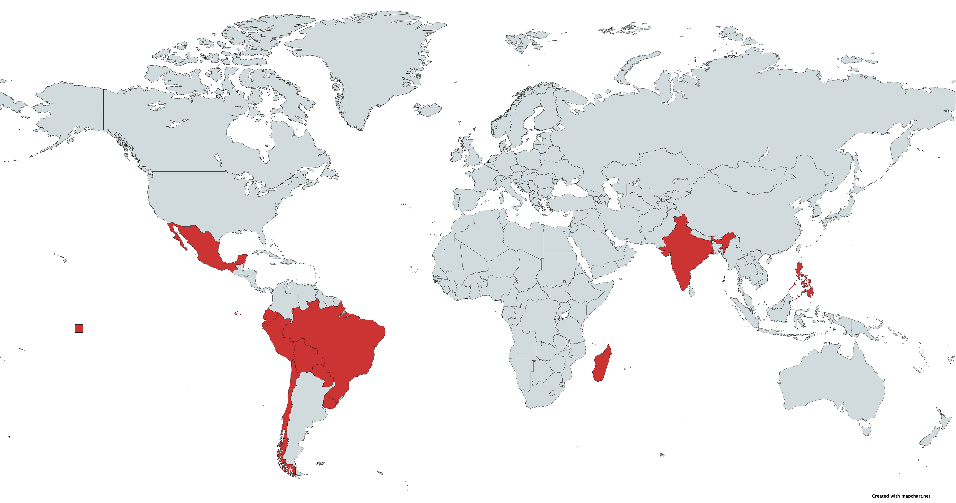
PGS in national legislation/regulation

Slide 4
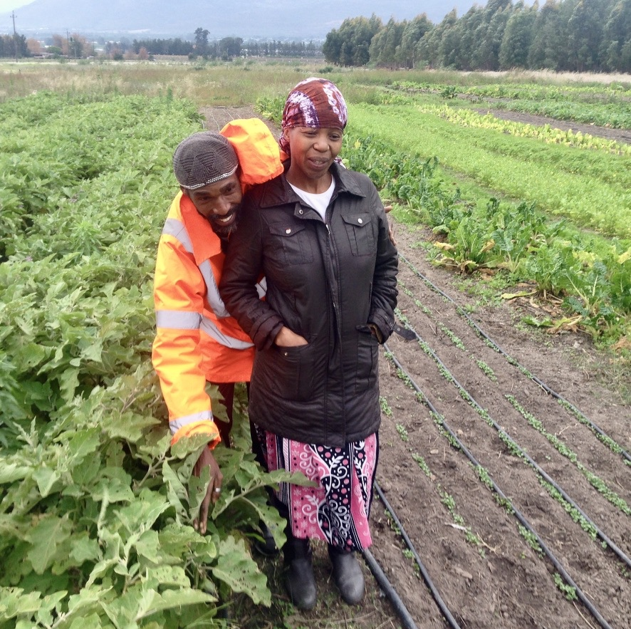
“The best way to find out if you can trust somebody is to trust them.”
Ernest Hemingway

Slide 5

The 6 Basic PGS elements
Shared vision
Participation
Transparency
Learning process
Horizontality
Elements 1-5 enables the 6th:
Trust
Notes:
Trust-integrity builds on pre-existing social structures and uses social and cultural controls; No one group holding power; decisions are decentralized.
“The best way to find out if you can trust somebody is to trust them.” ― Ernest Hemingway

Slide 6
The 6 Basic PGS elements
Shared vision
Participation
Transparency
Learning process
Horizontality
Elements 1-5 enables the 6th:
Trust
Notes:
Trust-integrity builds on pre-existing social structures and uses social and cultural controls; No one group holding power; decisions are decentralized.
“The best way to find out if you can trust somebody is to trust them.” ― Ernest Hemingway

Slide 7
PGS develops well where:
Local market demand exists or has a high potential.
Local suppliers are active with the capacity to produce (surplus) organically.
Consumers require an organic guarantee.
Farmers require a way to furnish it.
An existing culture of collaboration and trust.
A local and short value/supply chain.
PGS is a social process and a labour of love.
Without a love for the soil and love for your neighbour, it will not flourish.
7
Notes:
7

Slide 8
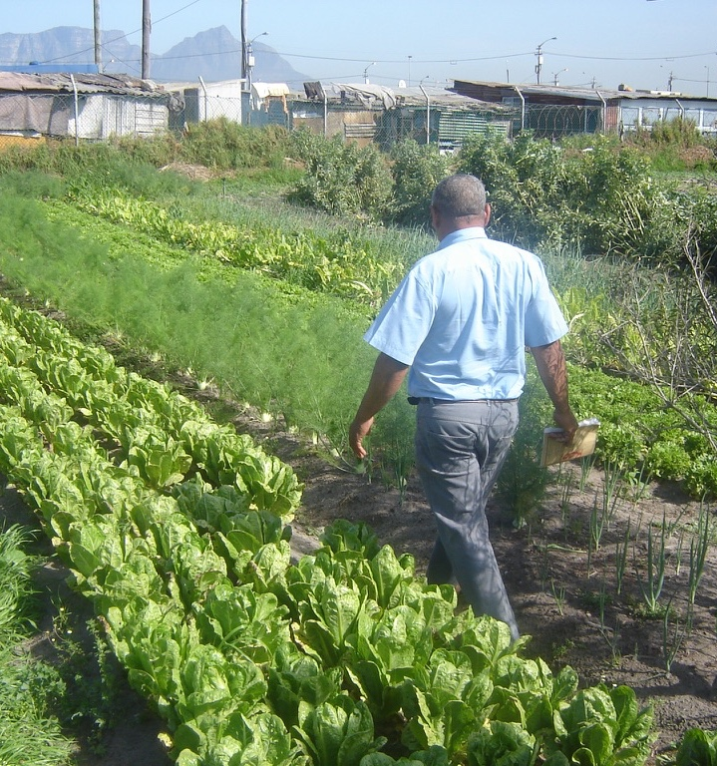
When should we encourage farmers to go to market?
When they:
have secure access to land,
want to farm,
are committed to organic principles,
are organised, and…
are capable of producing surplus!
“Survival > Subsistence > Sufficiency > Surplus”

Slide 9
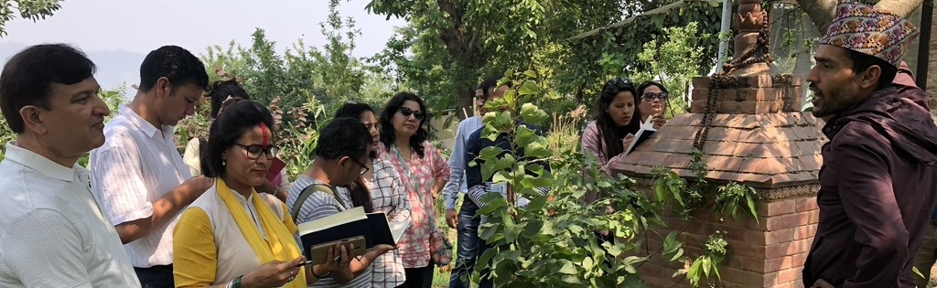
Locally appropriate assurance for local situations
Typical PGS are quality assurance initiatives that:
are locally relevant;
emphasize the participation of stakeholders, including producers and consumers;
operate outside the framework of third party certification.

Slide 10







Philippines – regulated PGS
Two ways to get organic certification
Pathway 1
3rd Party
OCB
Inspects
& certifies
Organic operator
produce
& supply
accredits
market
retailer
consumer
BAFS
Pathway 2
PGS
OCB
Farmer-member
ORGANIC AGRICULTURE
Regulatory Framework
Peer reviews
& certifies
Notes:
OAAS – Accreditation Section
OARS – Registration Section
OAVT – Validation Team
OANS – Networking Section
NOAB Secretariat

